Slide 1
齊容容
Iris Qi
Class of 2022

Slide 2
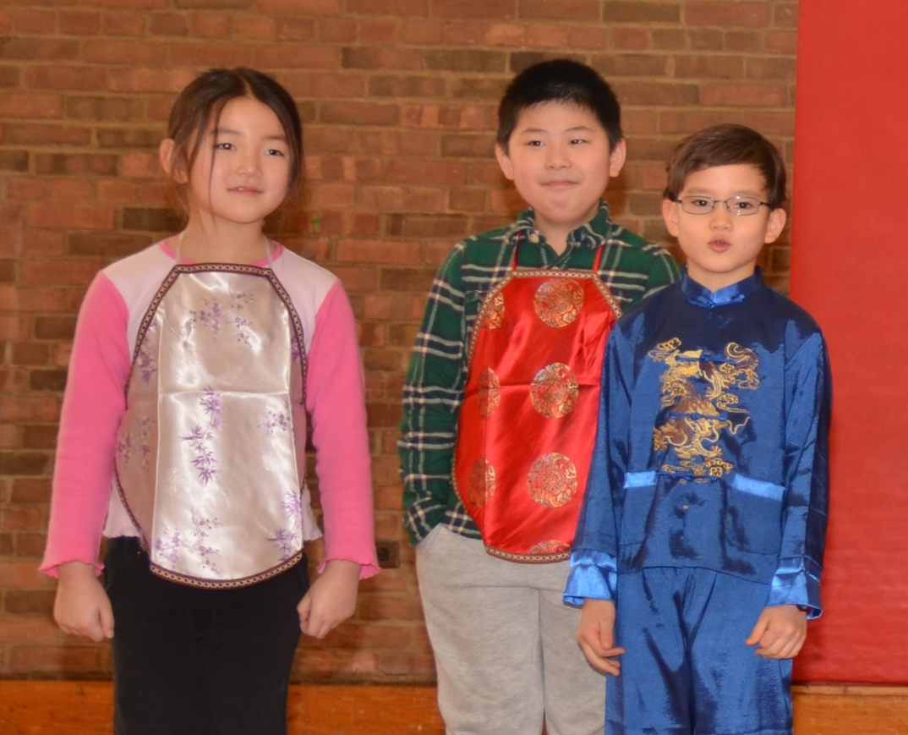
Hello everyone, my name is Iris Qi, and today I am going to graduate from Chinese school.
大家好，我叫齊容容，今年要從中文學校畢業了。
齊容容
Iris Qi
Class of 2022
02/07/2015

Slide 3
This is kind of sad for me because I have been coming here ever since I was very young.
我覺得有一點兒難過，因為我從小的時候就來到這兒了。
齊容容
Iris Qi
Class of 2022
02/07/2015

Slide 4
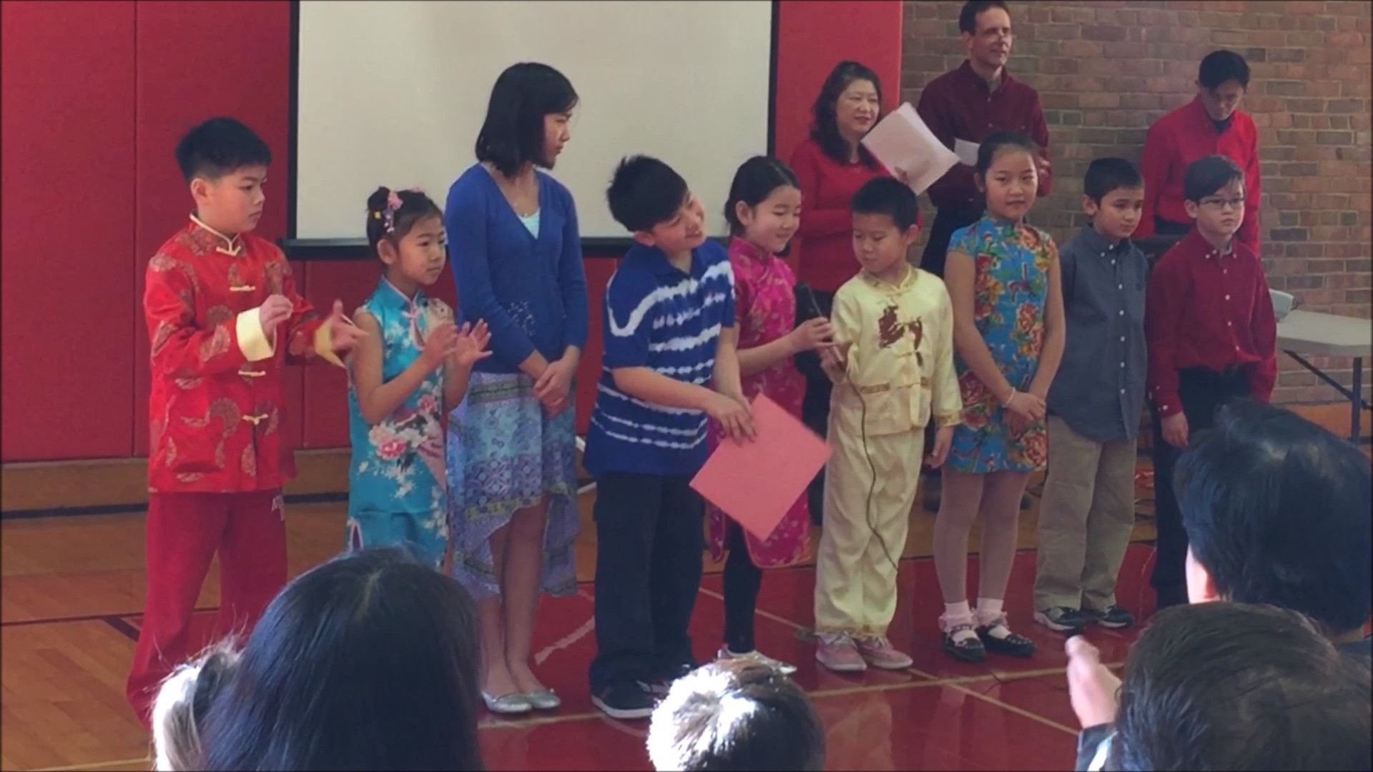
Every year I would watch the older kids graduate,
每年我看到那些大哥哥和大姐姐畢業，
齊容容
Iris Qi
Class of 2022
02/08/2016

Slide 5
and never thought I would one day be here giving this speech.
沒有想到我有一天也會離開這裡。
齊容容
Iris Qi
Class of 2022
02/08/2016

Slide 6
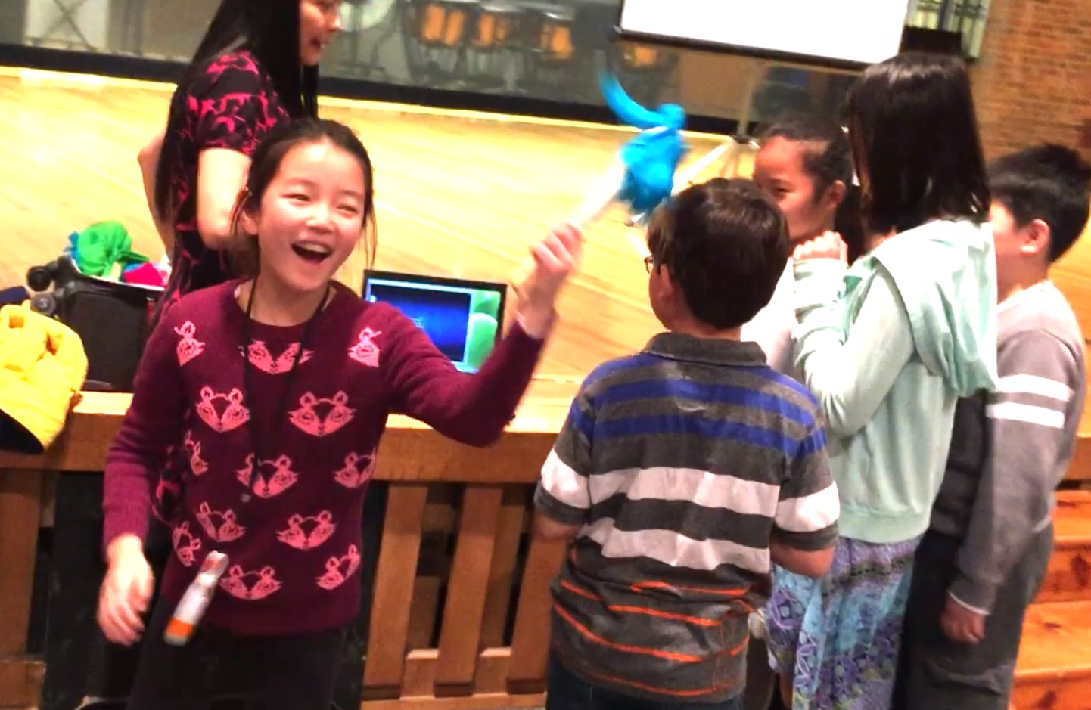
But right now, my classmates and I have grown up and are also going to graduate.
現在，我和我的同學長大了，也要畢業了。
齊容容
Iris Qi
Class of 2022
04/30/2016

Slide 7
When I was younger, I never wanted to come to Chinese school,
我小時候不會想要來中文學校，
齊容容
Iris Qi
Class of 2022
04/30/2016

Slide 8
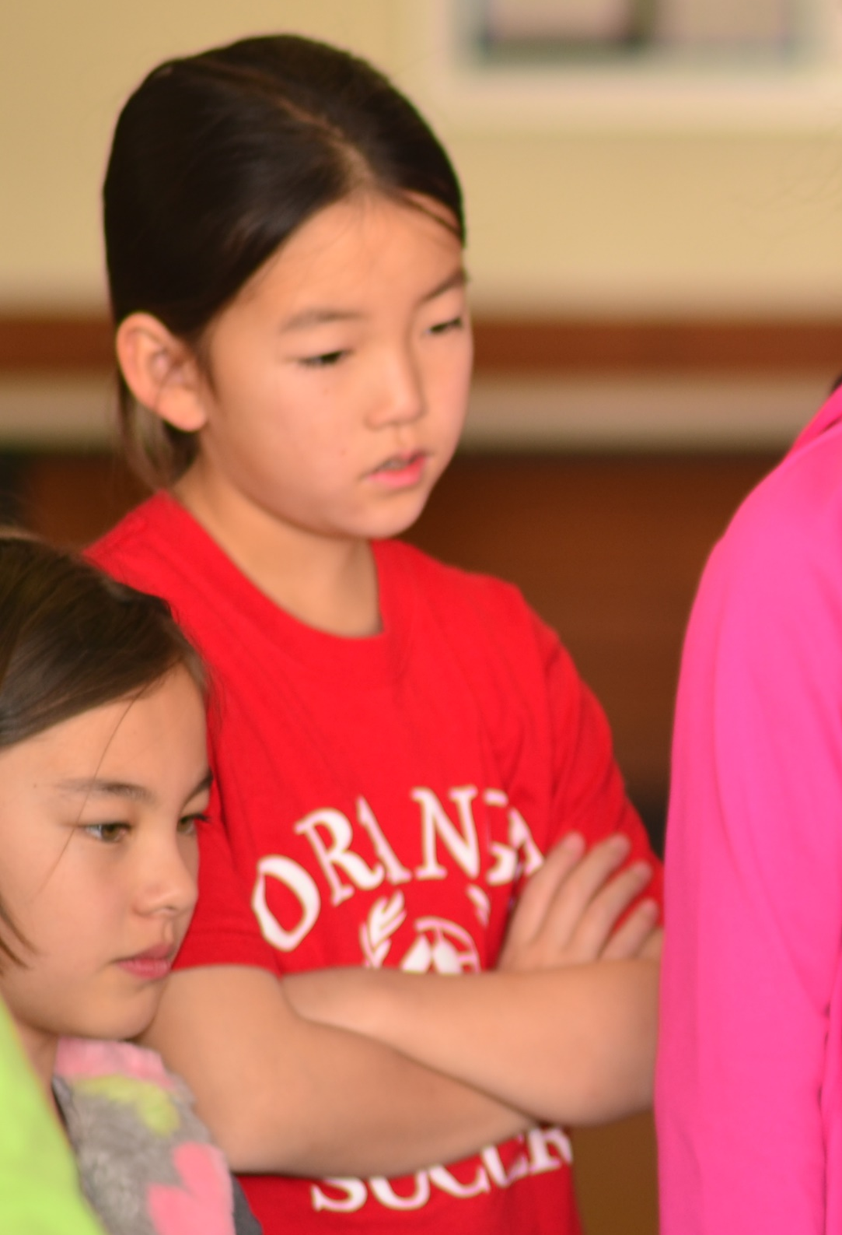
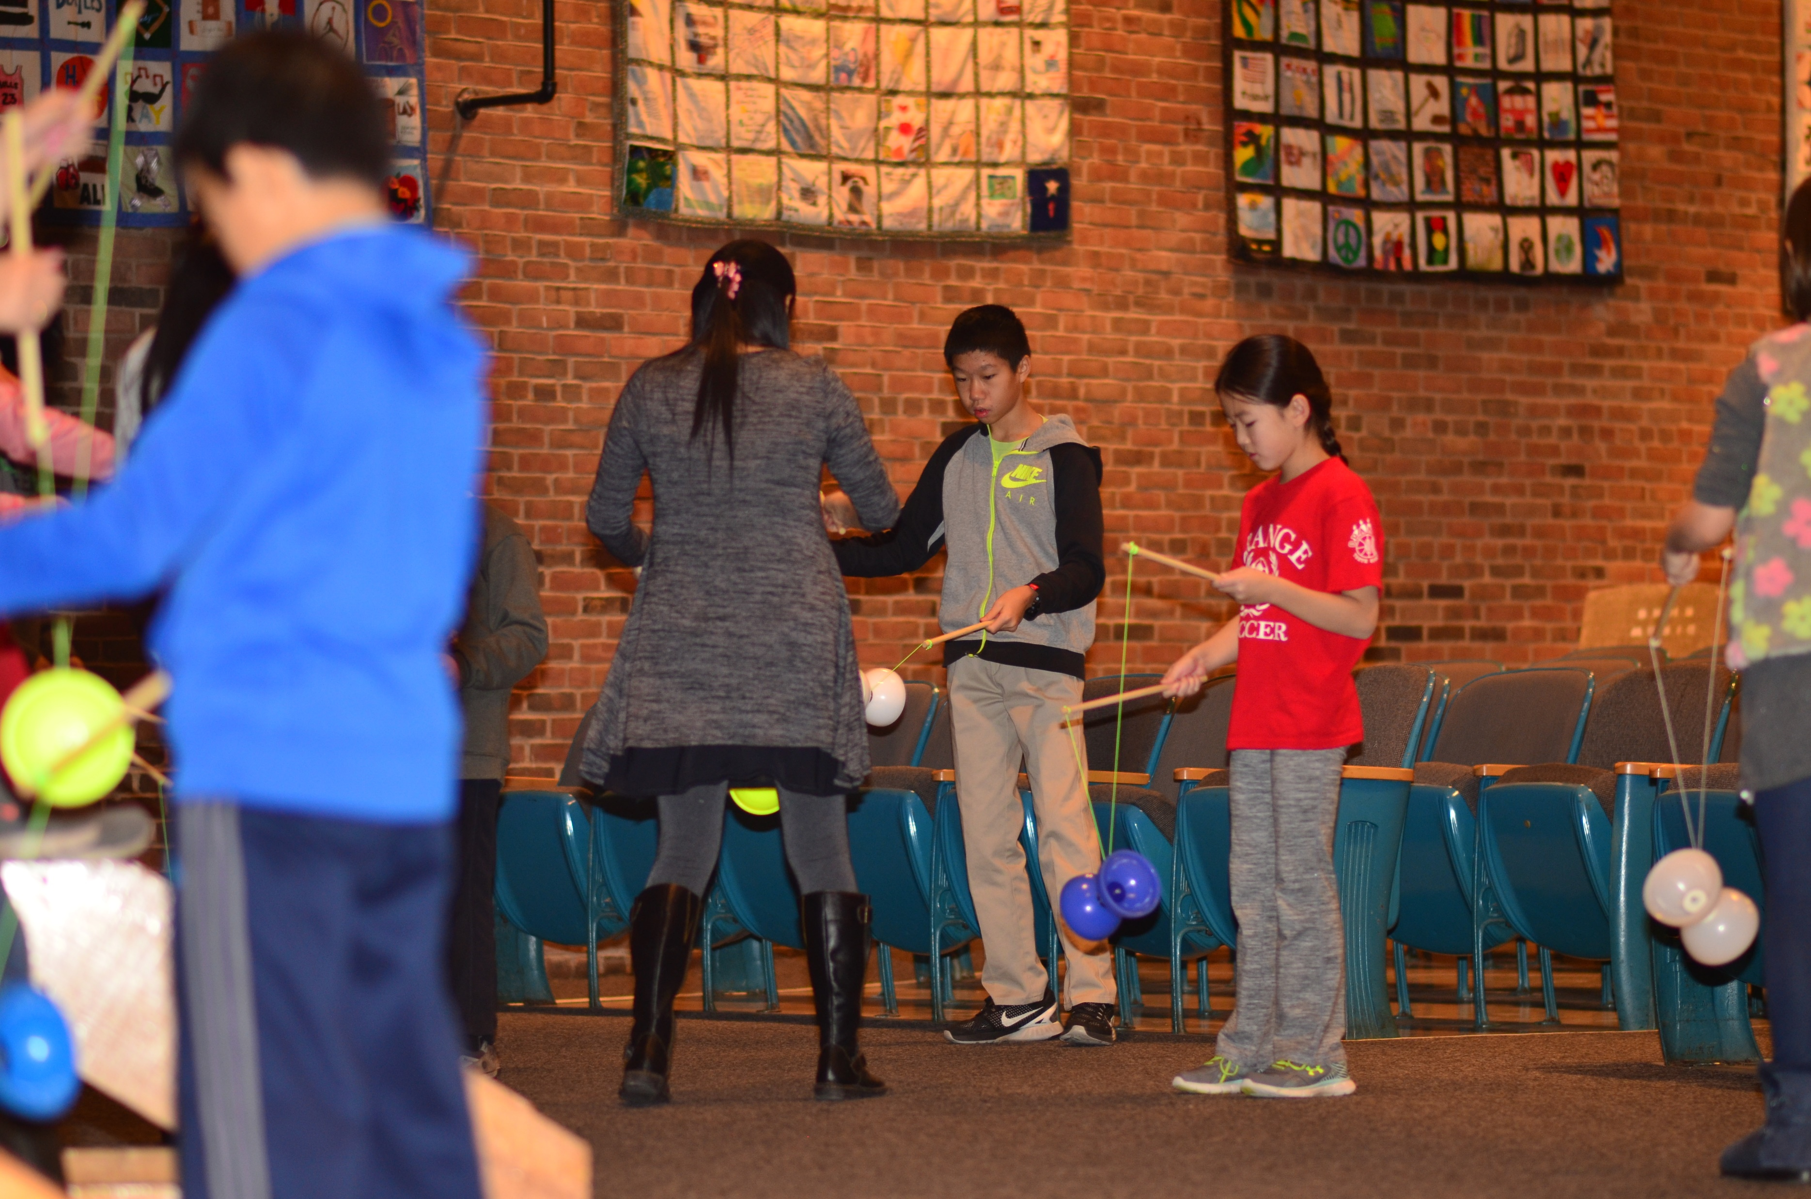
but now I enjoy coming here.
但是我現在特別喜歡這個地方。
齊容容
Iris Qi
Class of 2022
12/10/2016

Slide 9
I also never used to think that learning Chinese was something useful,
雖然這個地方給我溫暖及安全的感覺，
齊容容
Iris Qi
Class of 2022
12/10/2016

Slide 10
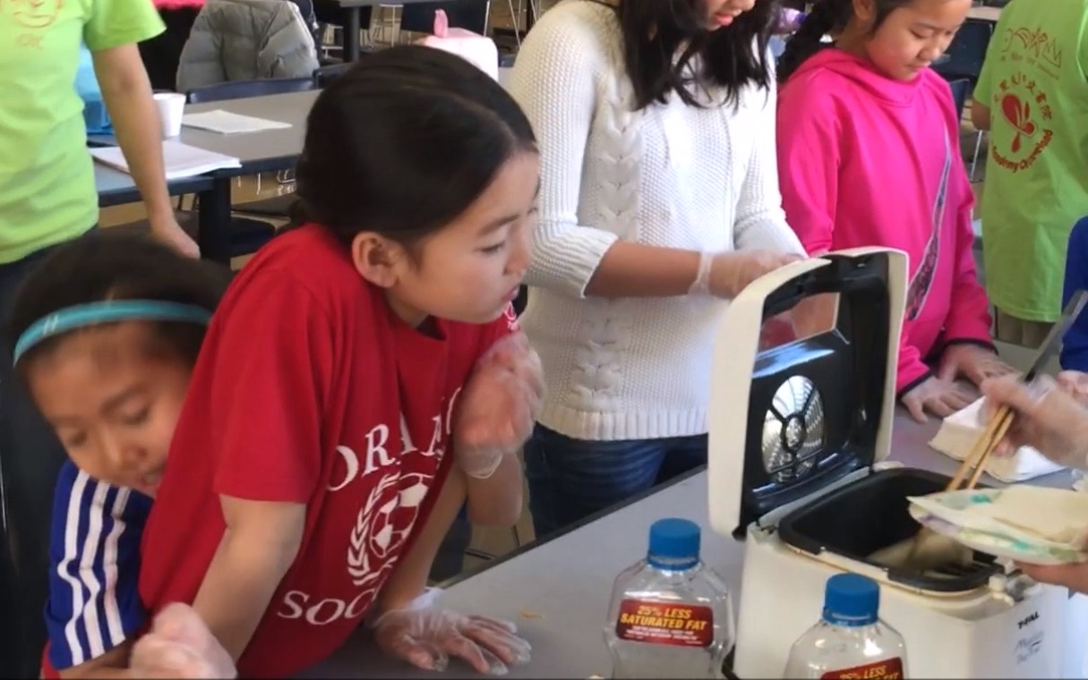
though this place has always been a place where I always feel welcomed and safe.
但是我以前從來不認為學中文很重要。
齊容容
Iris Qi
Class of 2022
12/10/2016

Slide 11
We learned how to read, write, and speak Chinese
我們在這裡學到怎麼讀、寫、說，
齊容容
Iris Qi
Class of 2022
12/10/2016

Slide 12
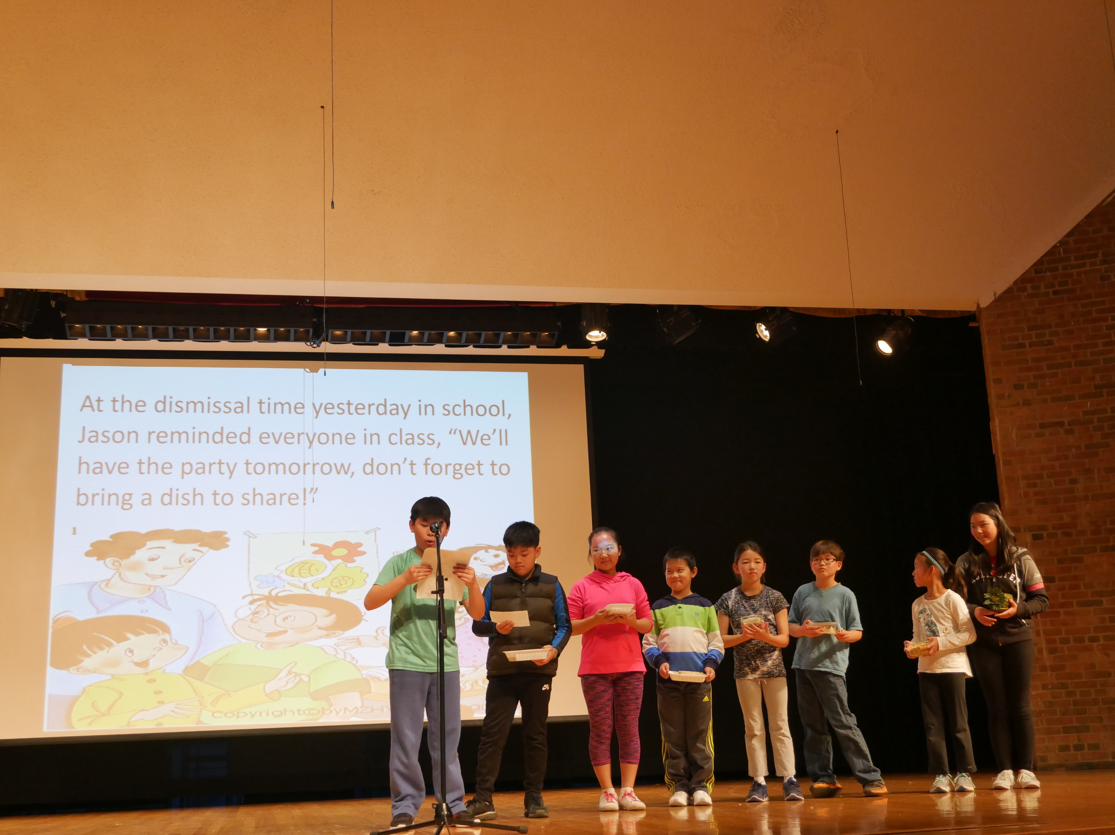
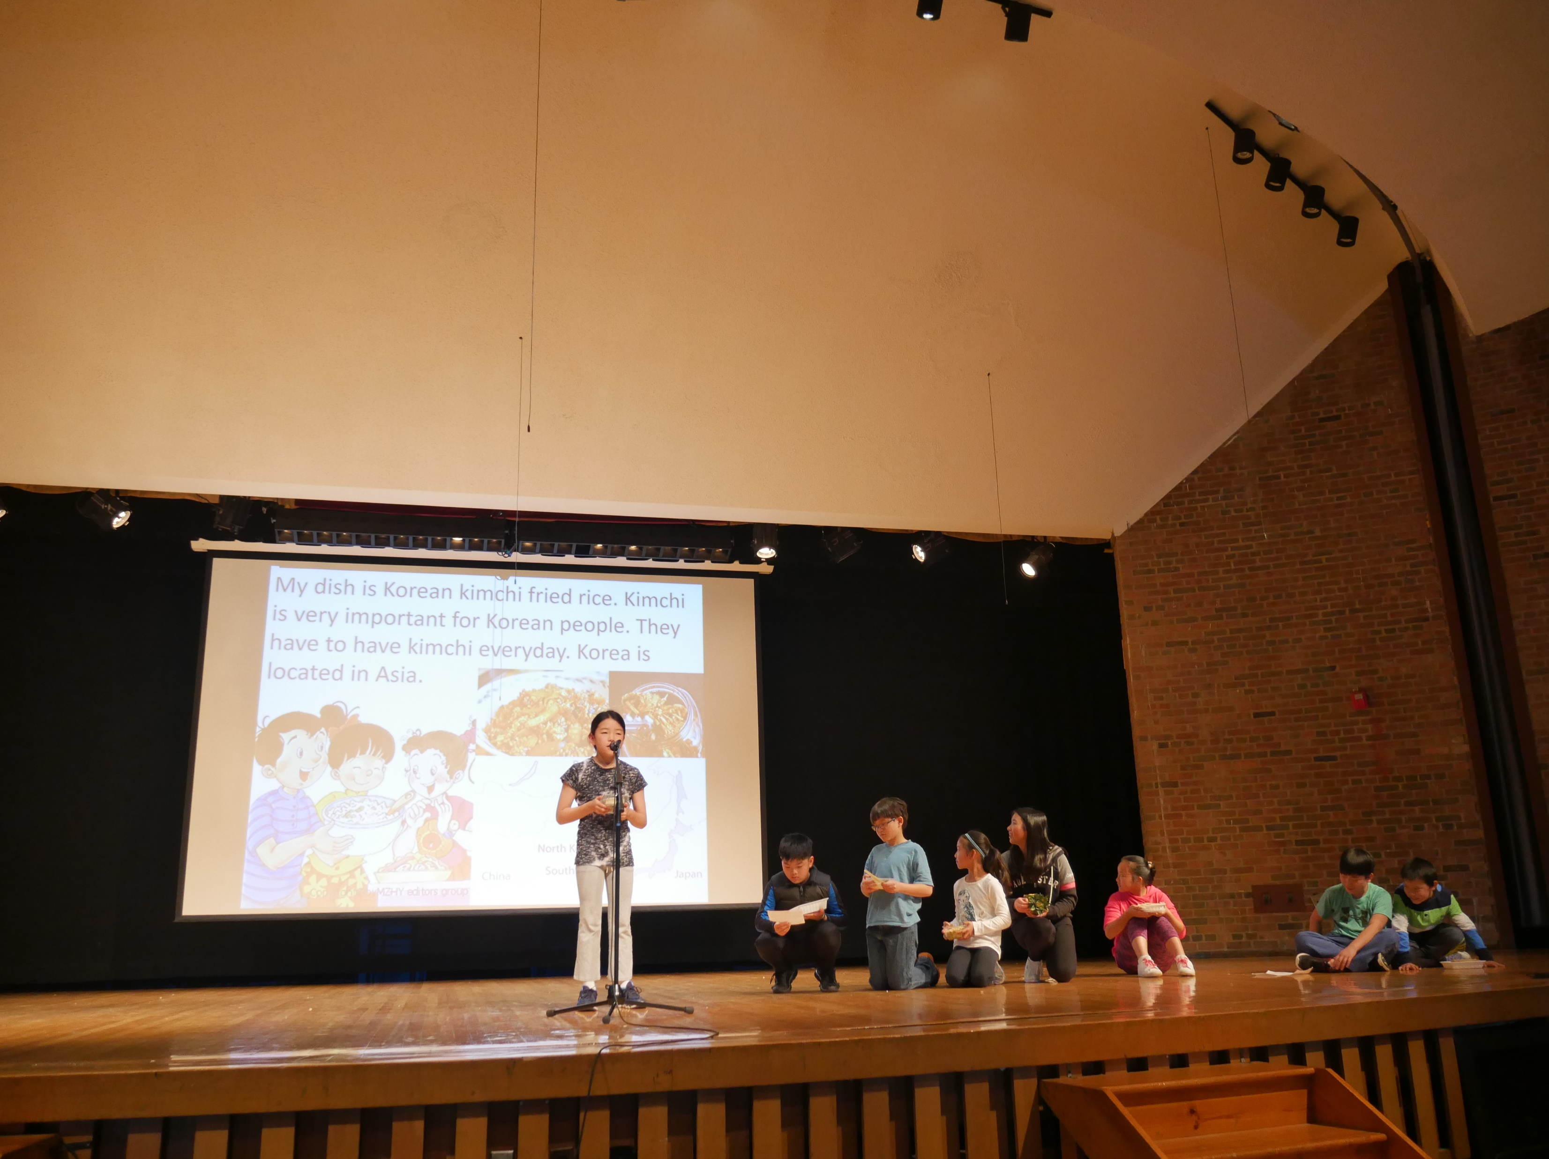
while also connecting with our very special culture.
也學到了很特別的文化，
齊容容
Iris Qi
Class of 2022
04/29/2017

Slide 13
I’ve created many happy memories here.
在這兒也留下了很多美好的回憶。
齊容容
Iris Qi
Class of 2022
04/29/2017

Slide 14
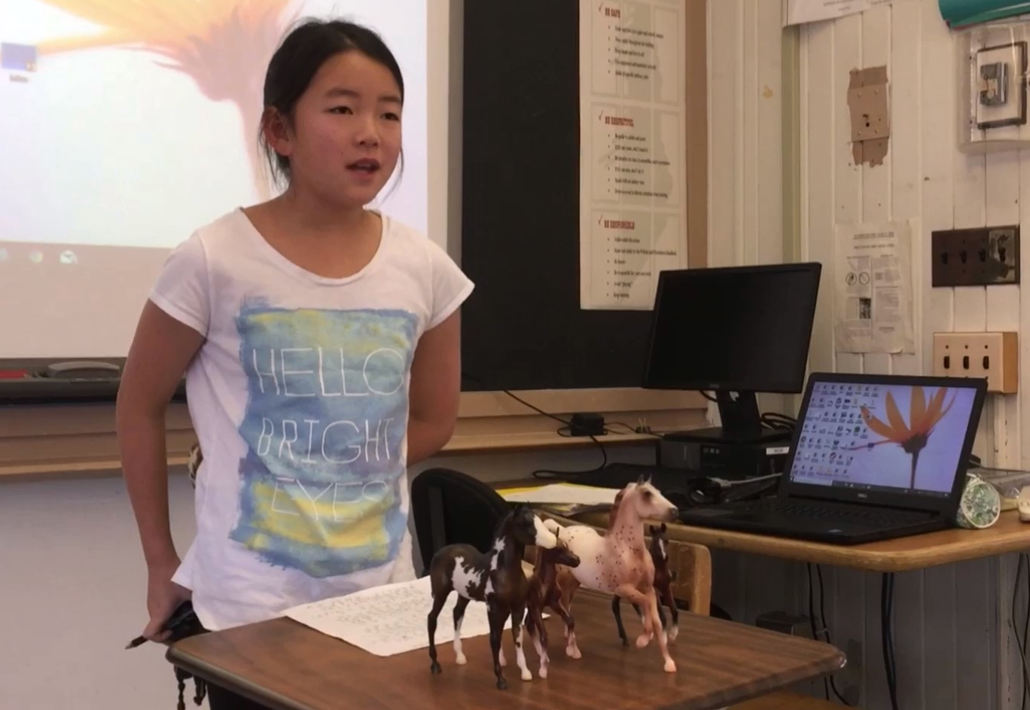
I’ll always remember the games we played during cultural week,
我永遠會記得文化週的遊戲，
齊容容
Iris Qi
Class of 2022
12/02/2017

Slide 15
playing mahjong with my classmates, and all of the other good times we’ve had.
跟同學們玩麻將，以及所有快樂的時光。
齊容容
Iris Qi
Class of 2022
12/02/2017

Slide 16
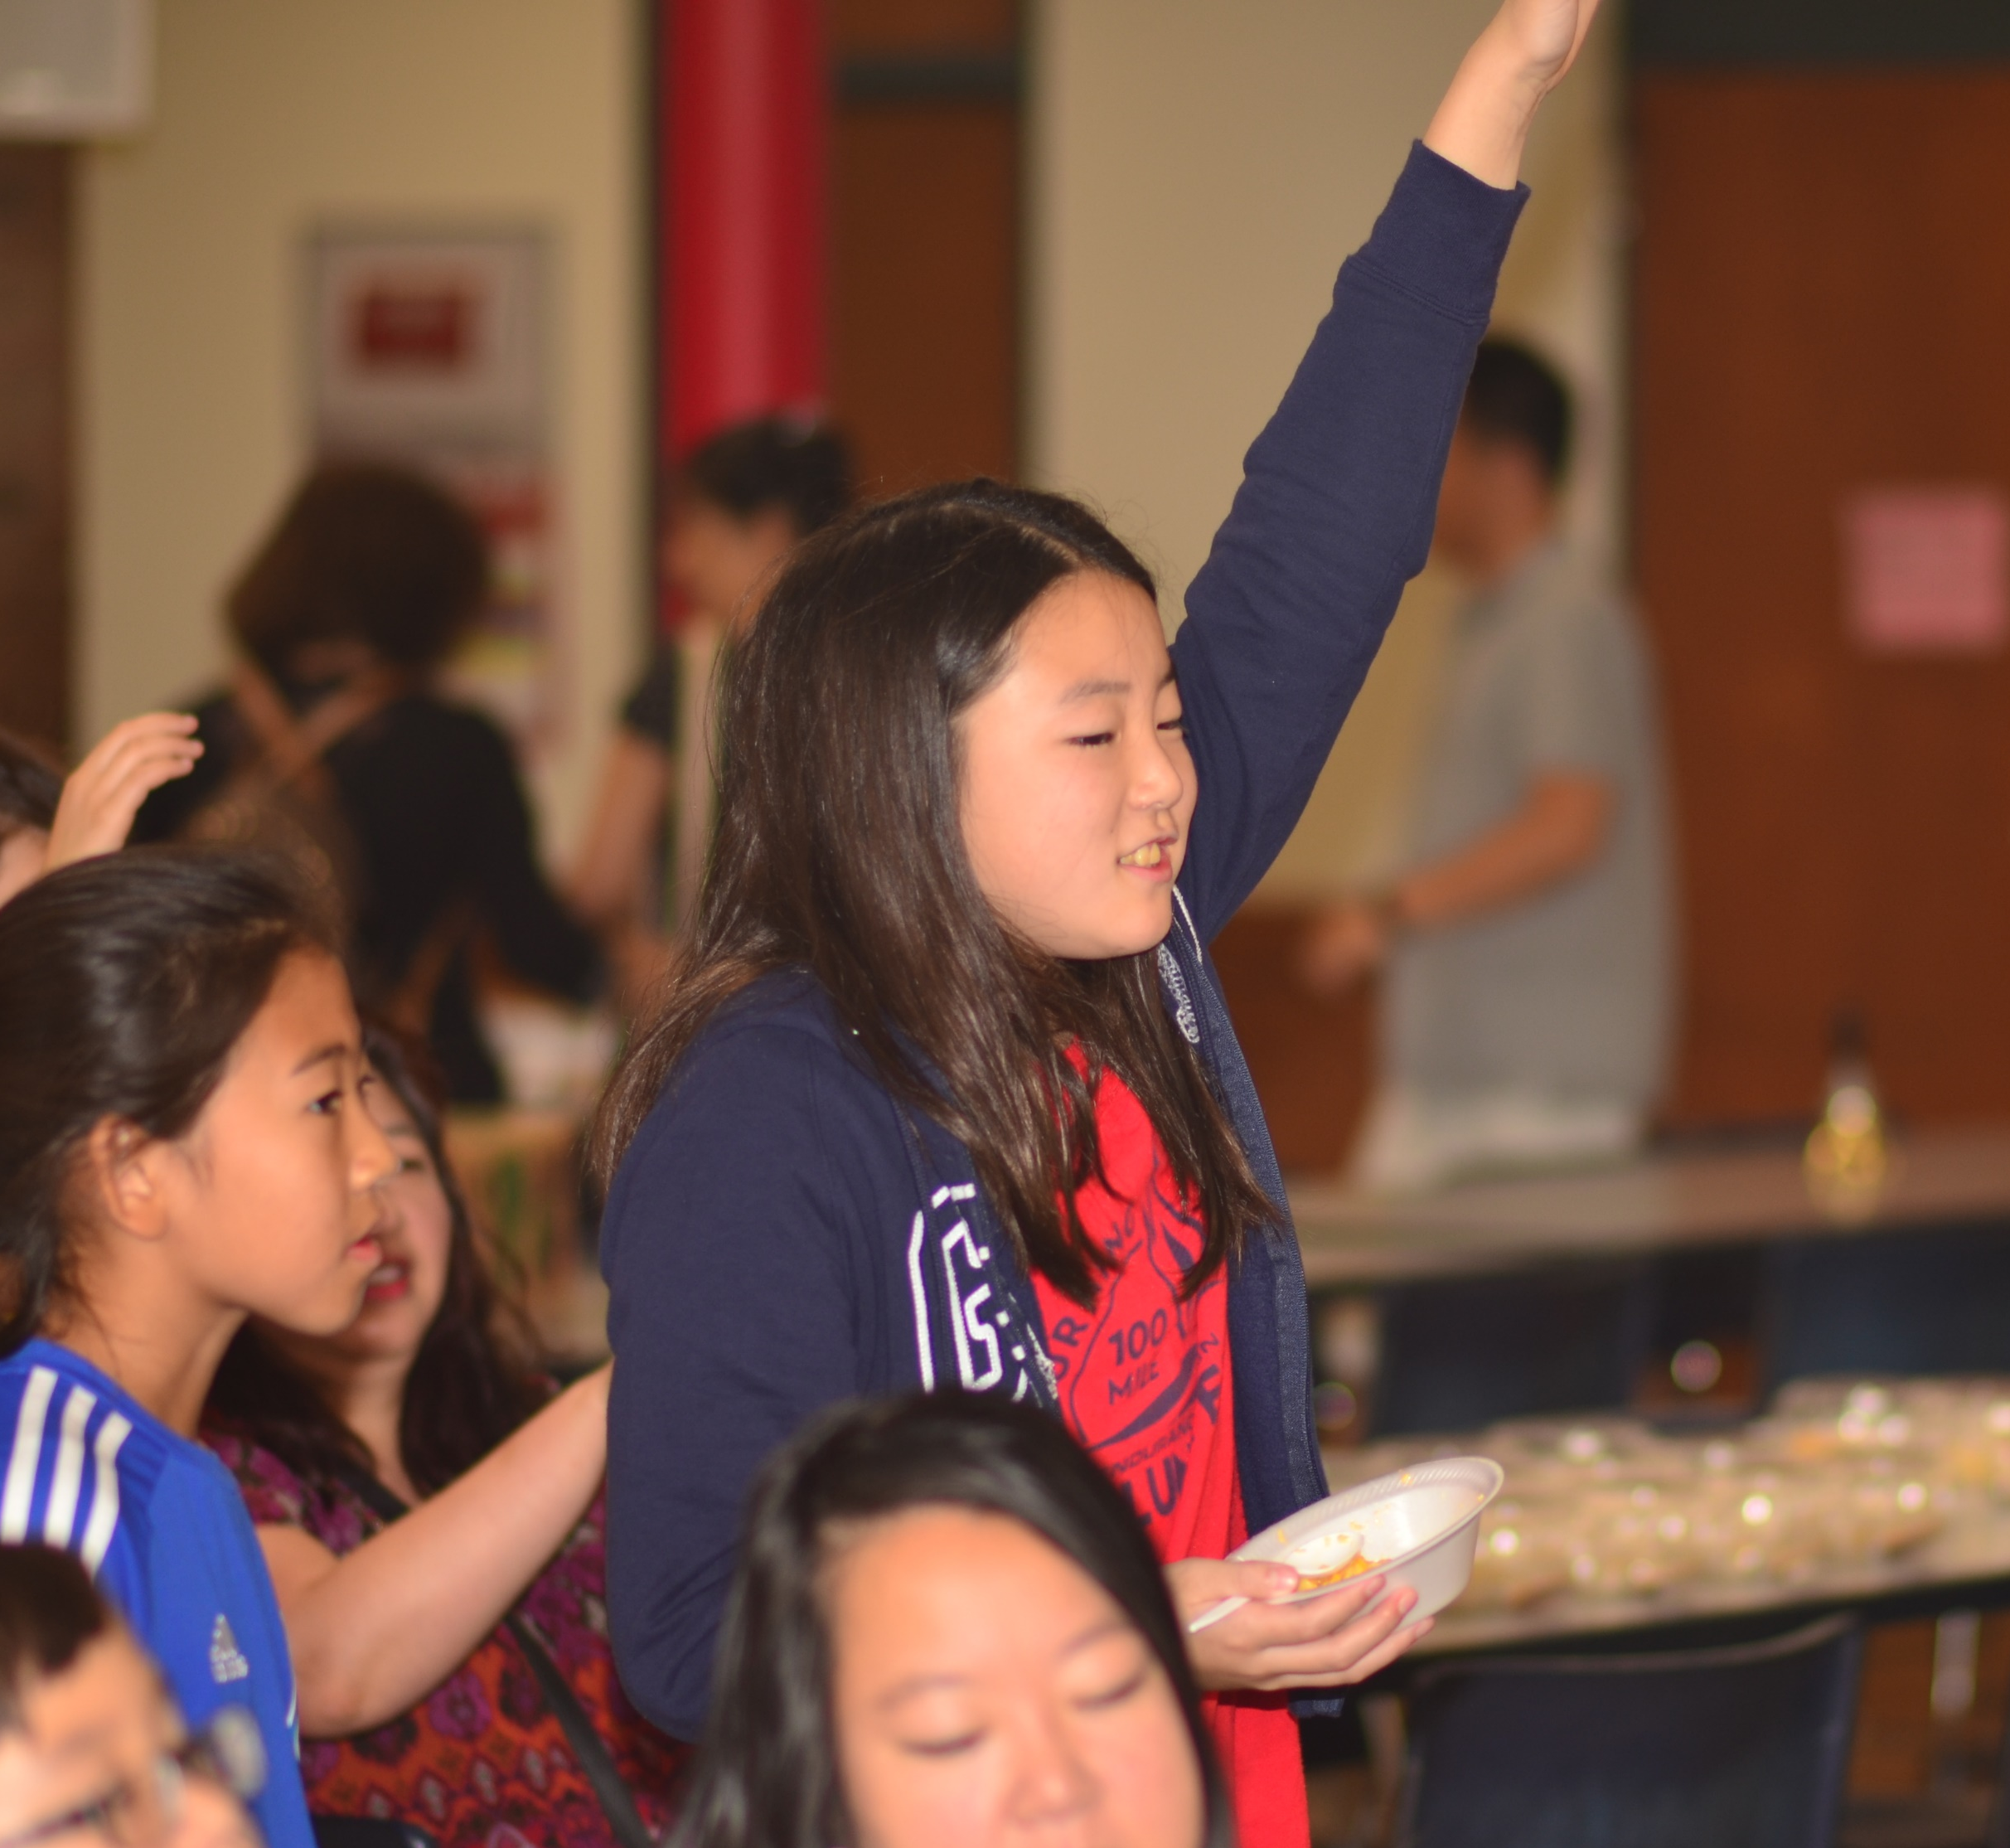
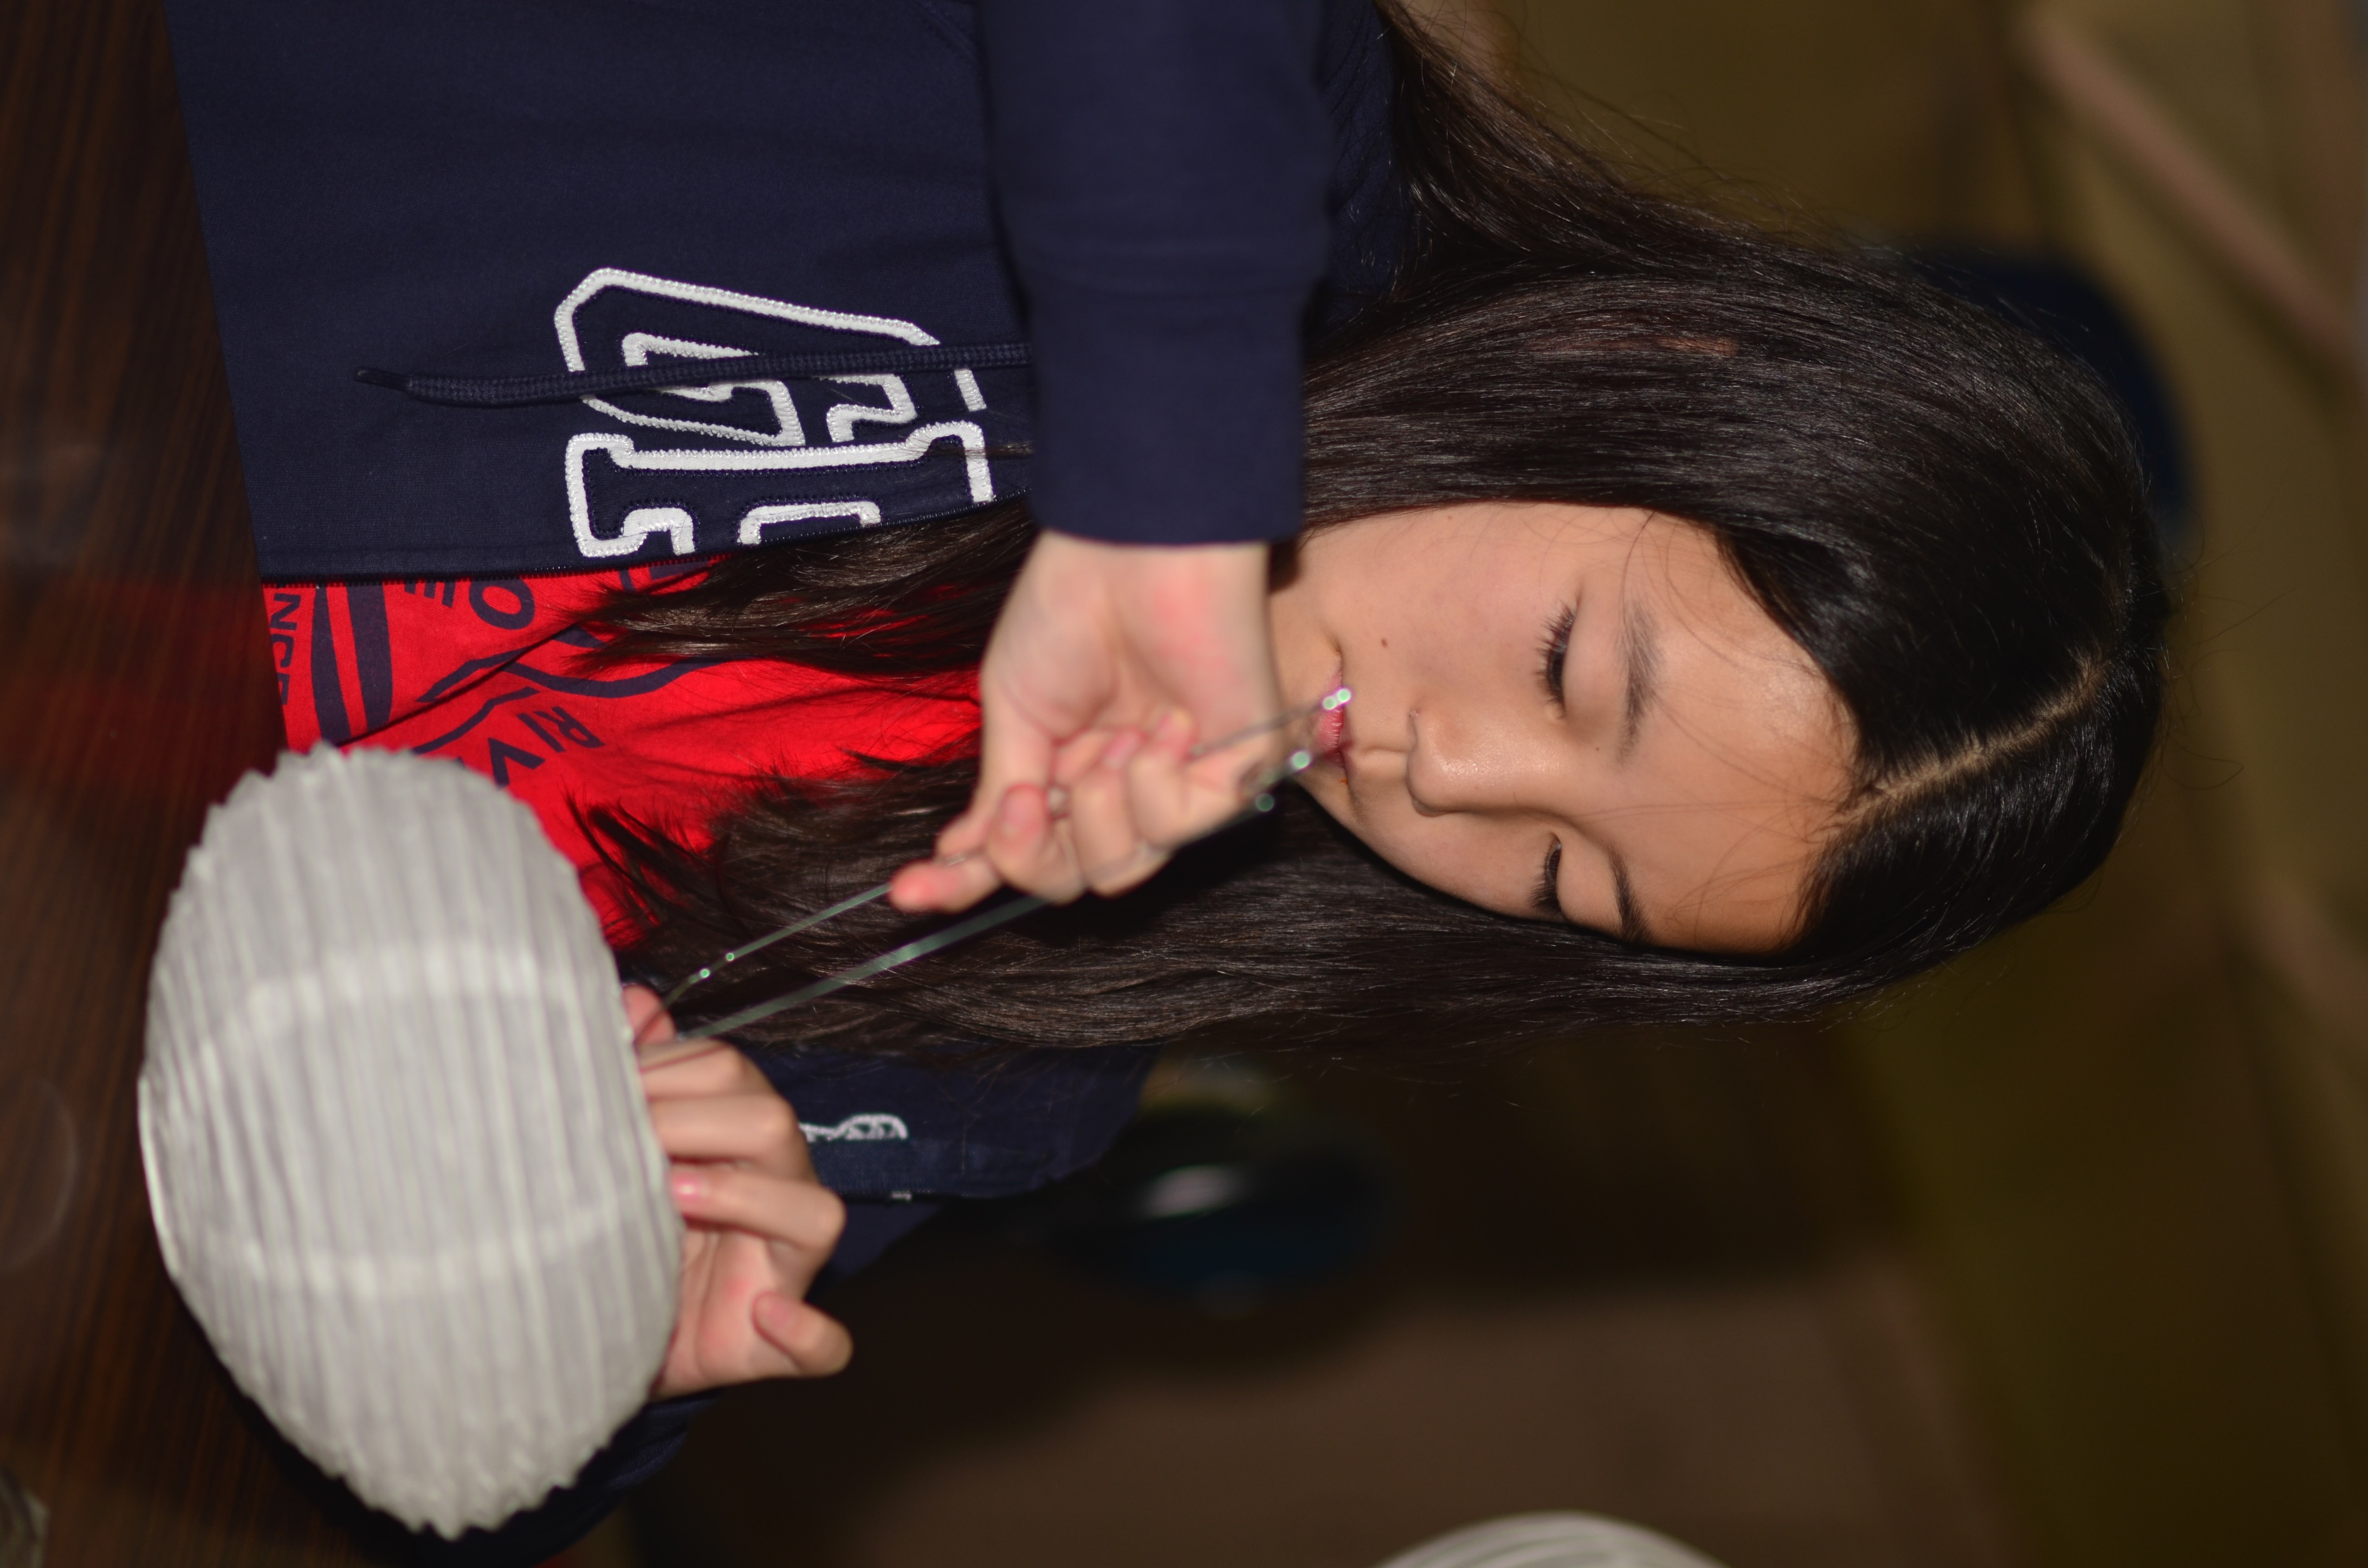
This will be an experience that I will always look back on fondly.
我會永遠記得中文學校的一切，
我覺得這裡真的幫著我培養自己的文化。
齊容容
Iris Qi
Class of 2022
09/22/2018

Slide 17
I really have to thank my mom and dad
特別要感謝我的爸爸和媽媽，
齊容容
Iris Qi
Class of 2022
09/22/2018

Slide 18
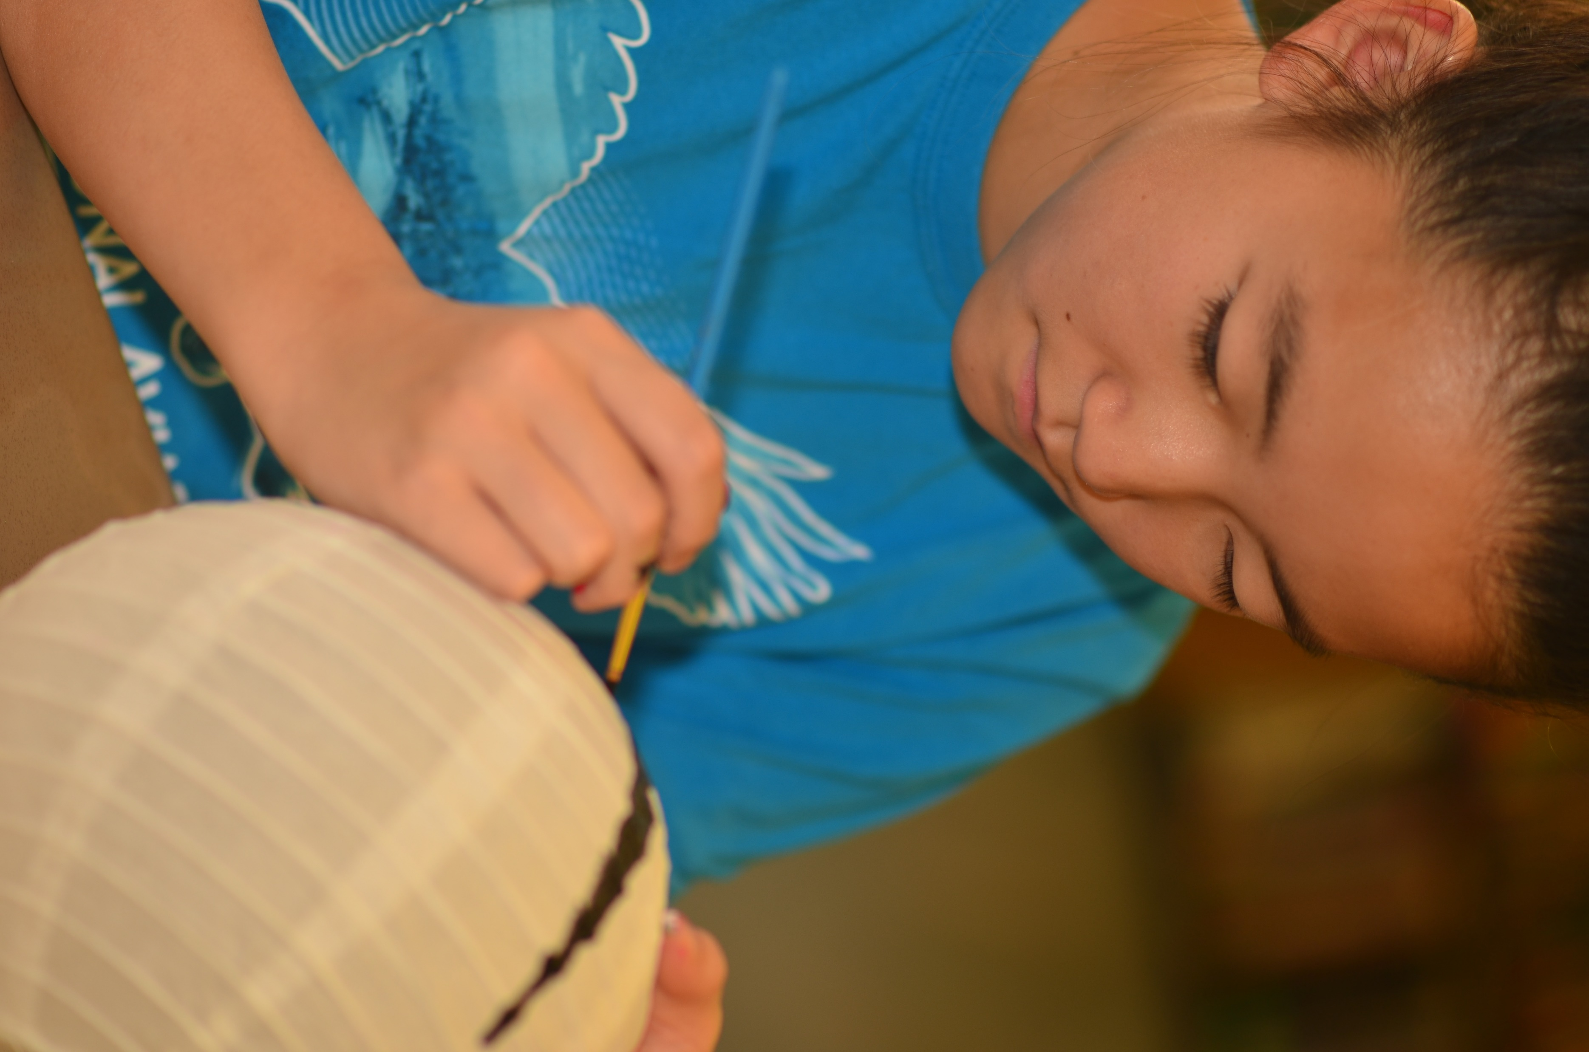
for bringing me to Chinese school every Saturday
每星期六帶我們去中文學校，
齊容容
Iris Qi
Class of 2022
09/28/2019

Slide 19
and who made me feel proud of my heritage.
讓我覺得身為中國人很驕傲。
齊容容
Iris Qi
Class of 2022
09/28/2019

Slide 20
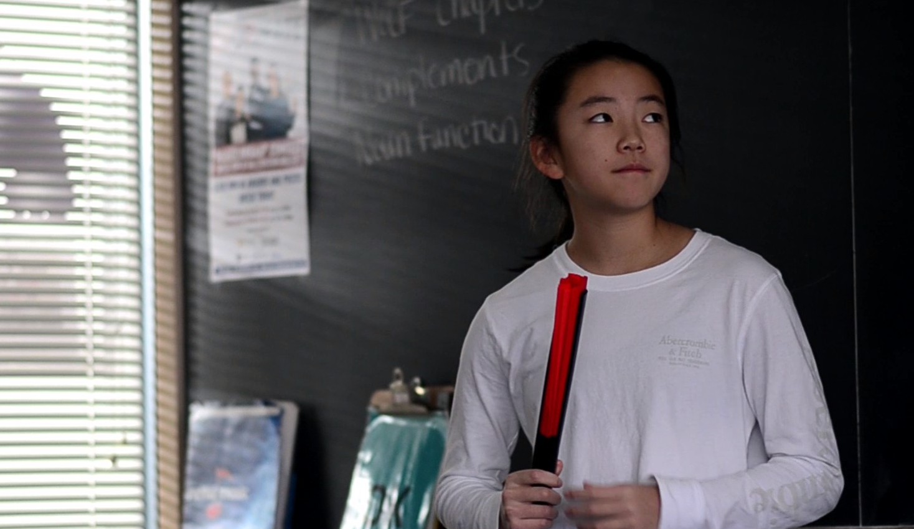
I also have to thank all of the teachers who have taught me
也要感謝所有的中文老師，
齊容容
Iris Qi
Class of 2022
11/02/2019

Slide 21
because they did a really good job and put in their own time and effort to teach us.
因為他們把我的中文教好，花這麼多時間教我們，
齊容容
Iris Qi
Class of 2022
11/02/2019

Slide 22
They created a very warm and fun environment to learn in as well.
又創造一個有趣的學習環境。
齊容容
Iris Qi
Class of 2022
11/02/2019

Slide 23
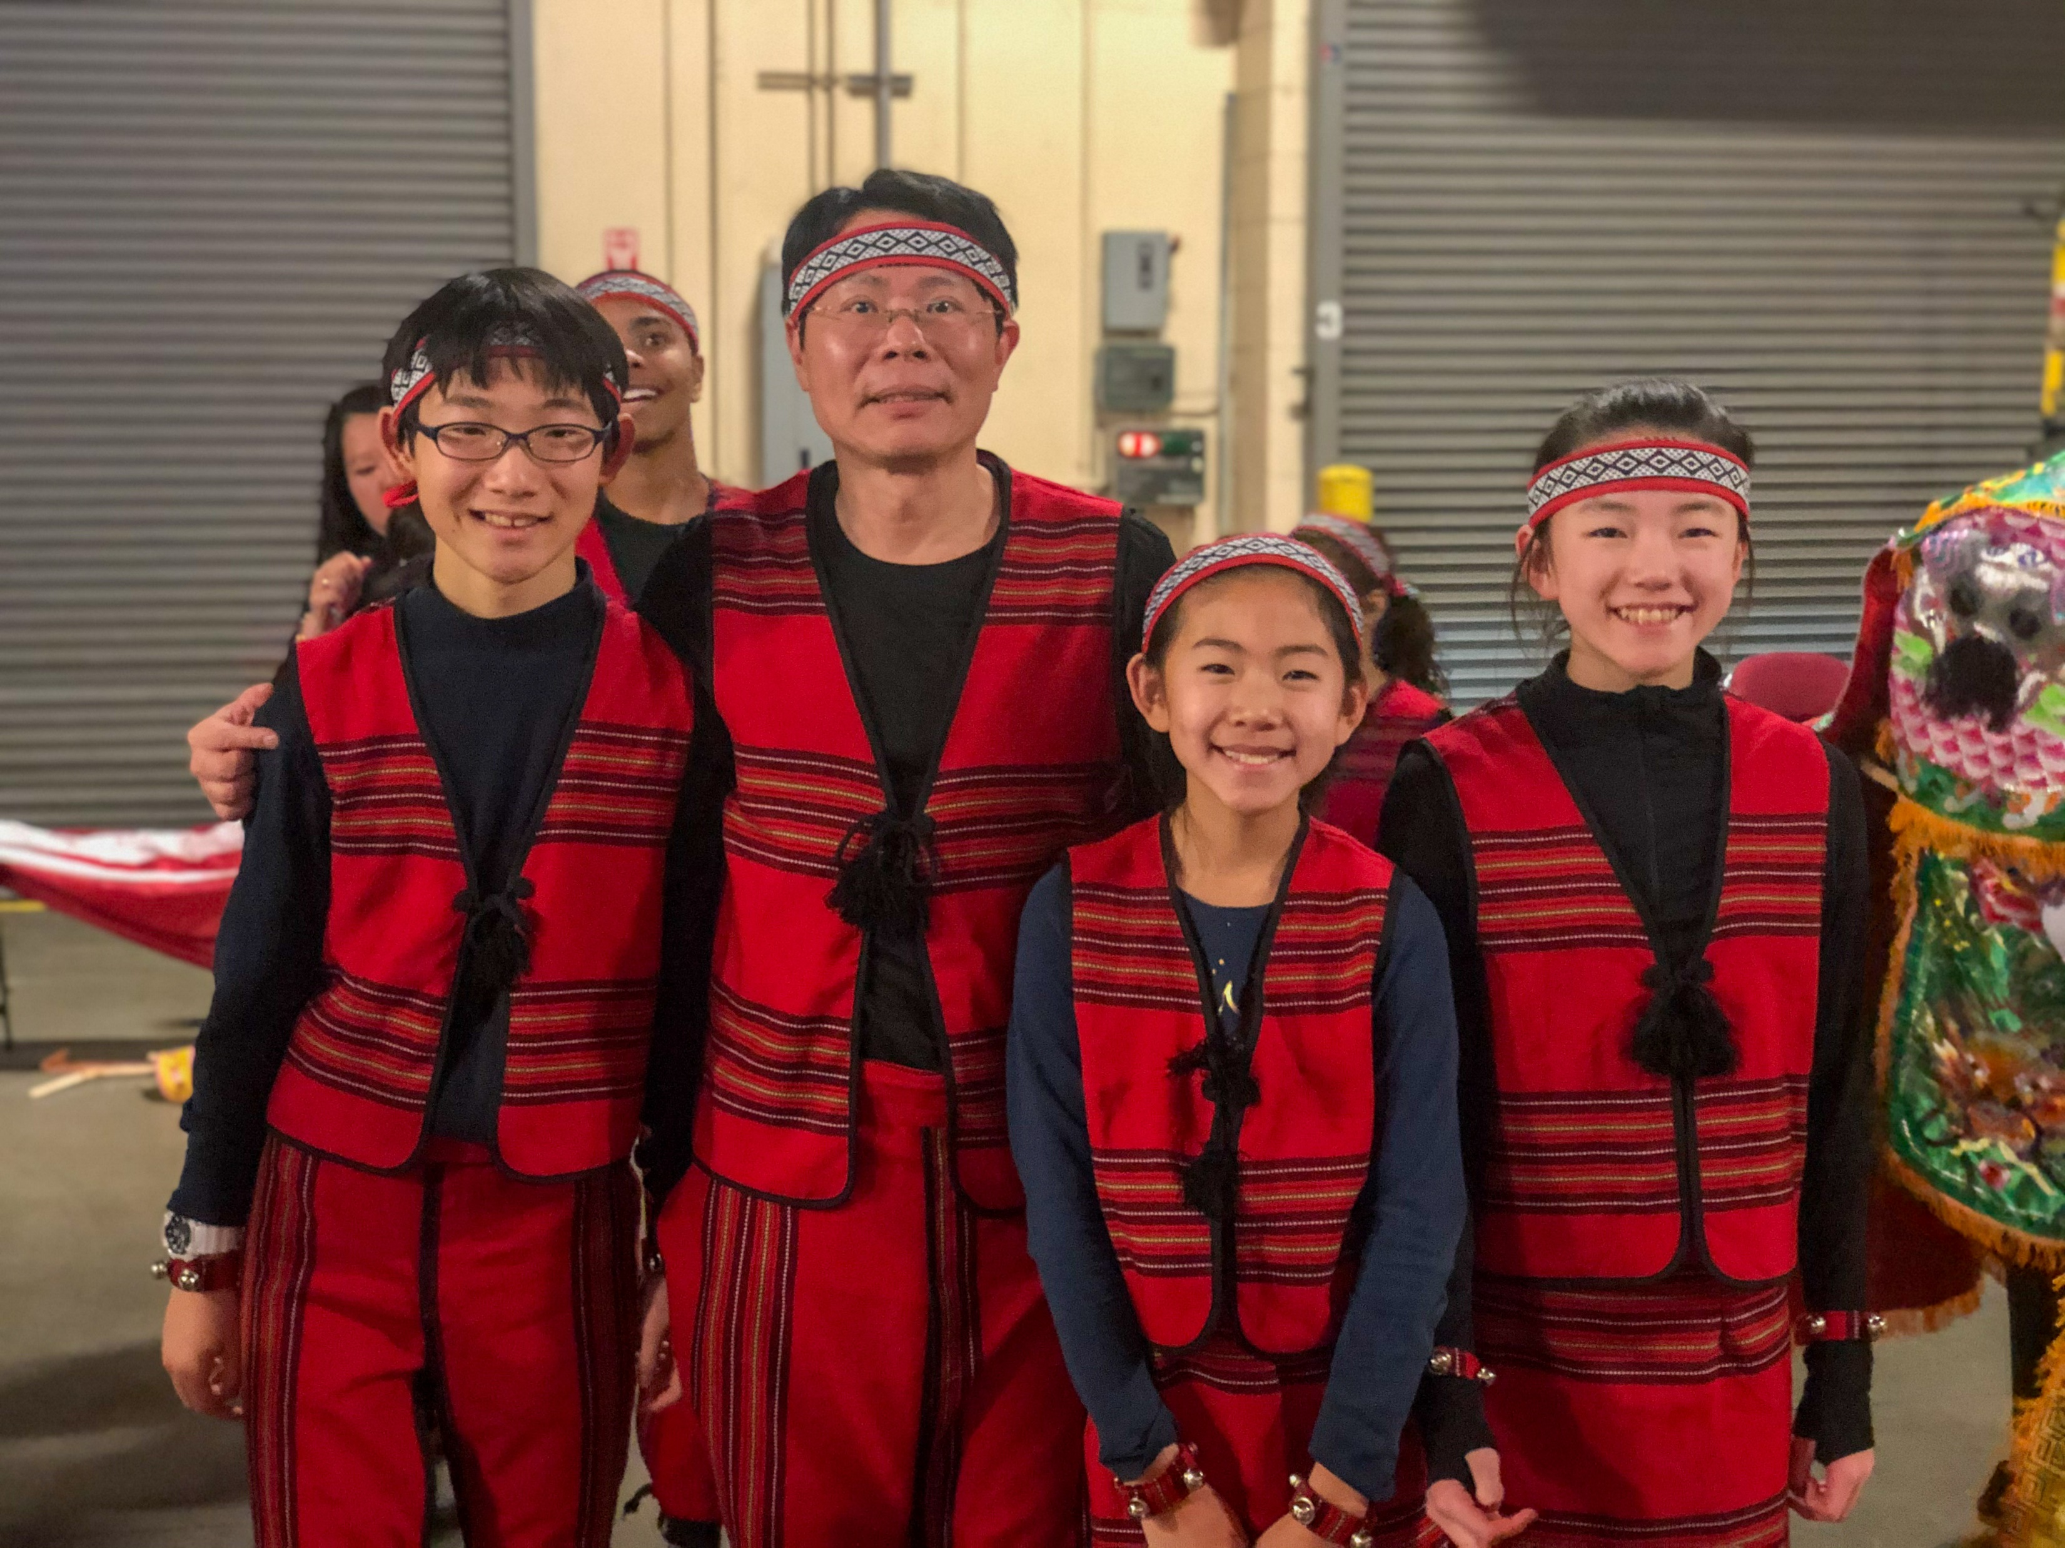
I’m also very grateful for Vivian and Andrew
也感謝 Vivian 和 Andrew
齊容容
Iris Qi
Class of 2022
01/25/2020

Slide 24
because we’ve been together since first grade and have been great friends.
從一年級到現在，都是我的好朋友。
齊容容
Iris Qi
Class of 2022
01/25/2020

Slide 25
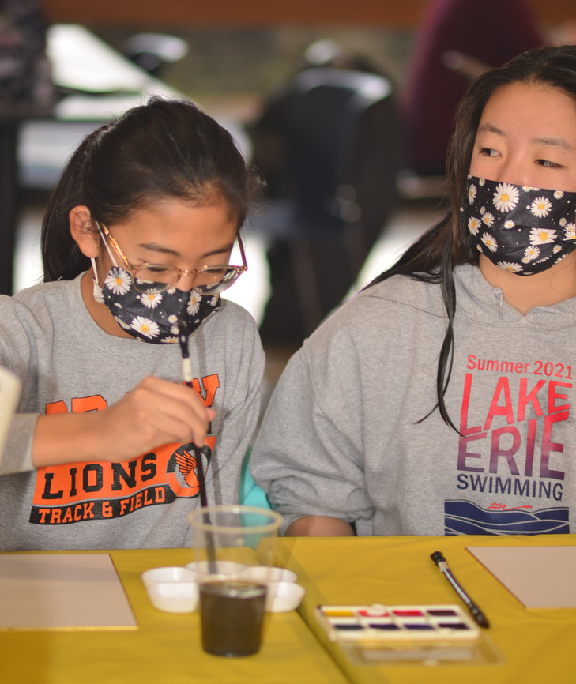
And finally, I would like to thank everyone at Chinese school.
然後我需要說，我們中文學校的人，
齊容容
Iris Qi
Class of 2022
12/11/2021

Slide 26
You guys are super cool.
「你們都特別酷！」
齊容容
Iris Qi
Class of 2022
12/11/2021

Slide 27
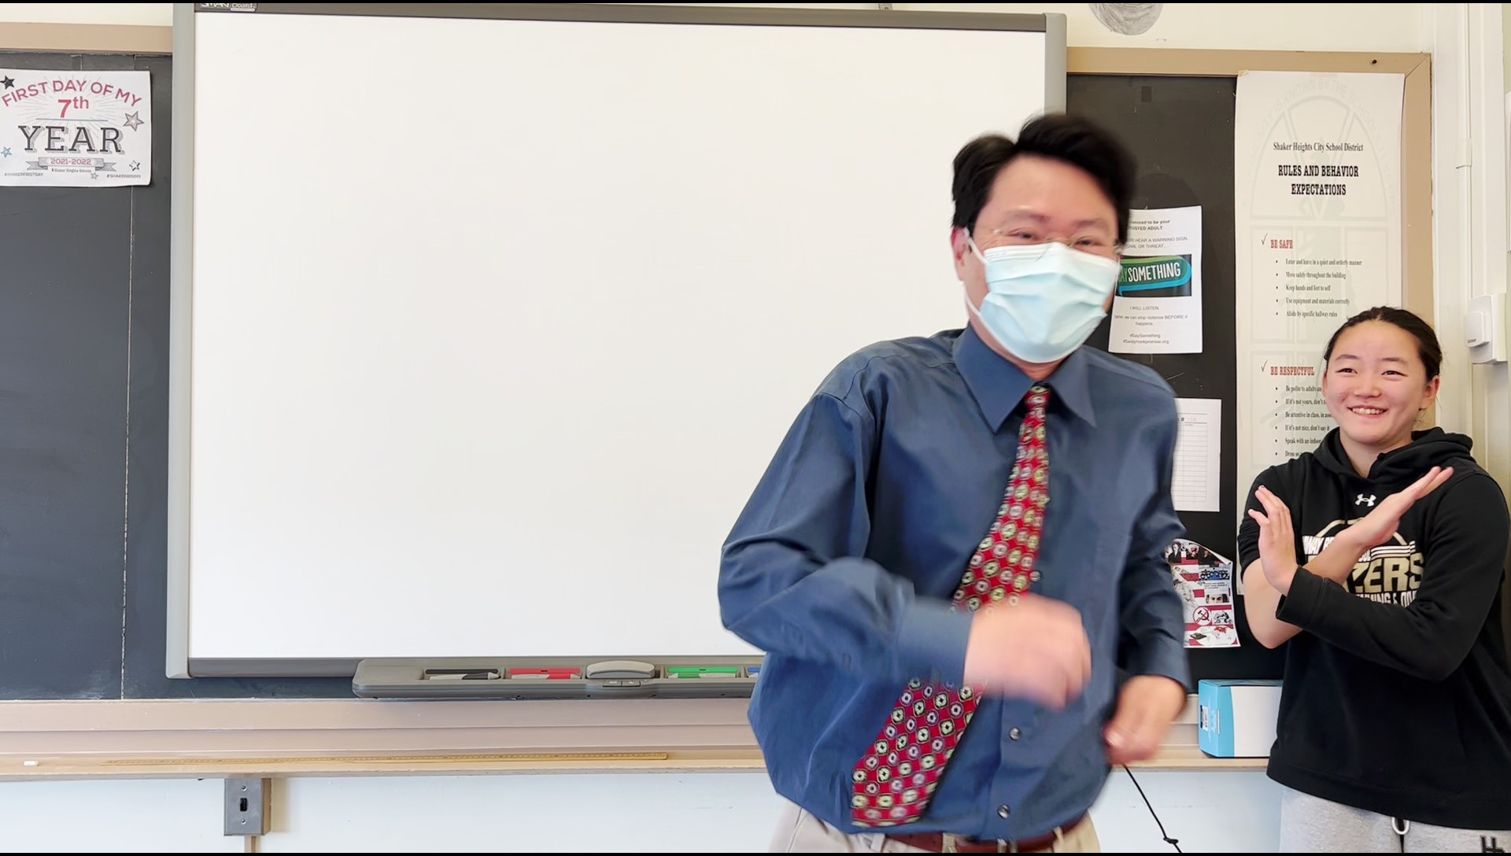
I will always love this place
我永遠會愛這個地方，
齊容容
Iris Qi
Class of 2022
04/16/2022

Slide 28
and it will carry a special place in my heart.
因為它在我的心裡，佔了一個很特別的地位。
齊容容
Iris Qi
Class of 2022
04/16/2022

Slide 29
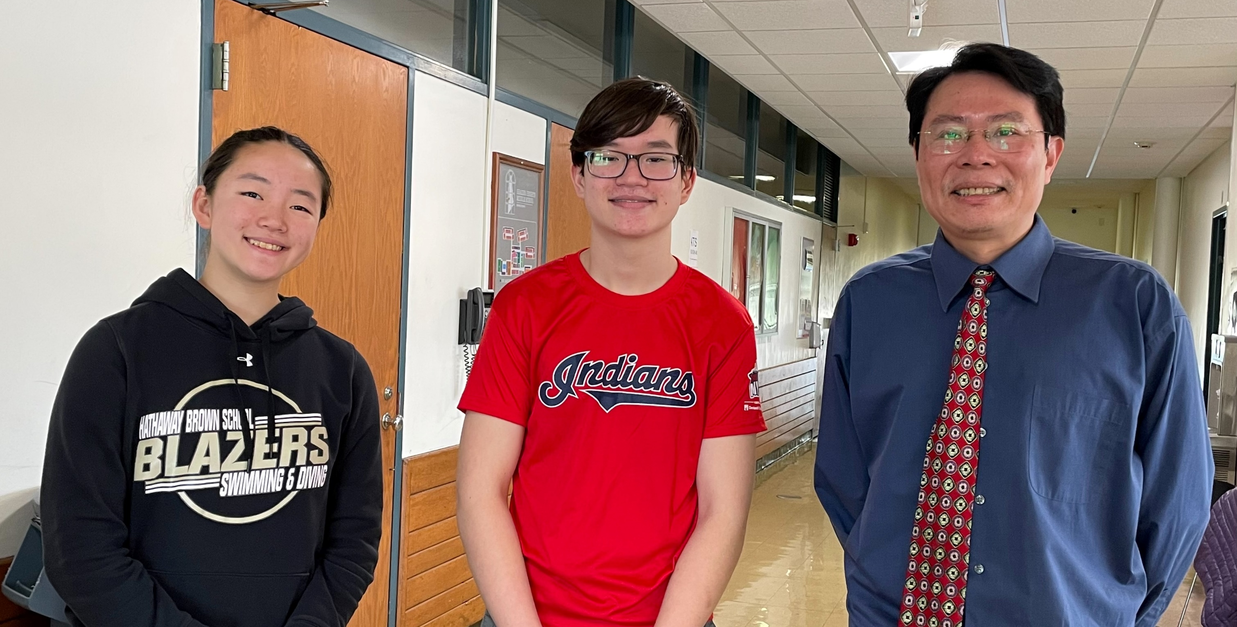
Thank you everyone!
謝謝大家！
齊容容
Iris Qi
Class of 2022
04/16/2022

