Slide 1
CAoC 5th Grade Parent Conference
Website
http://www.chineseacademyofcleveland.org/5th-grade.html
Syllabus (update frequently)
Weekly Curriculum、Homework
Weekly Parent Note
Test
Class Recording

Slide 2
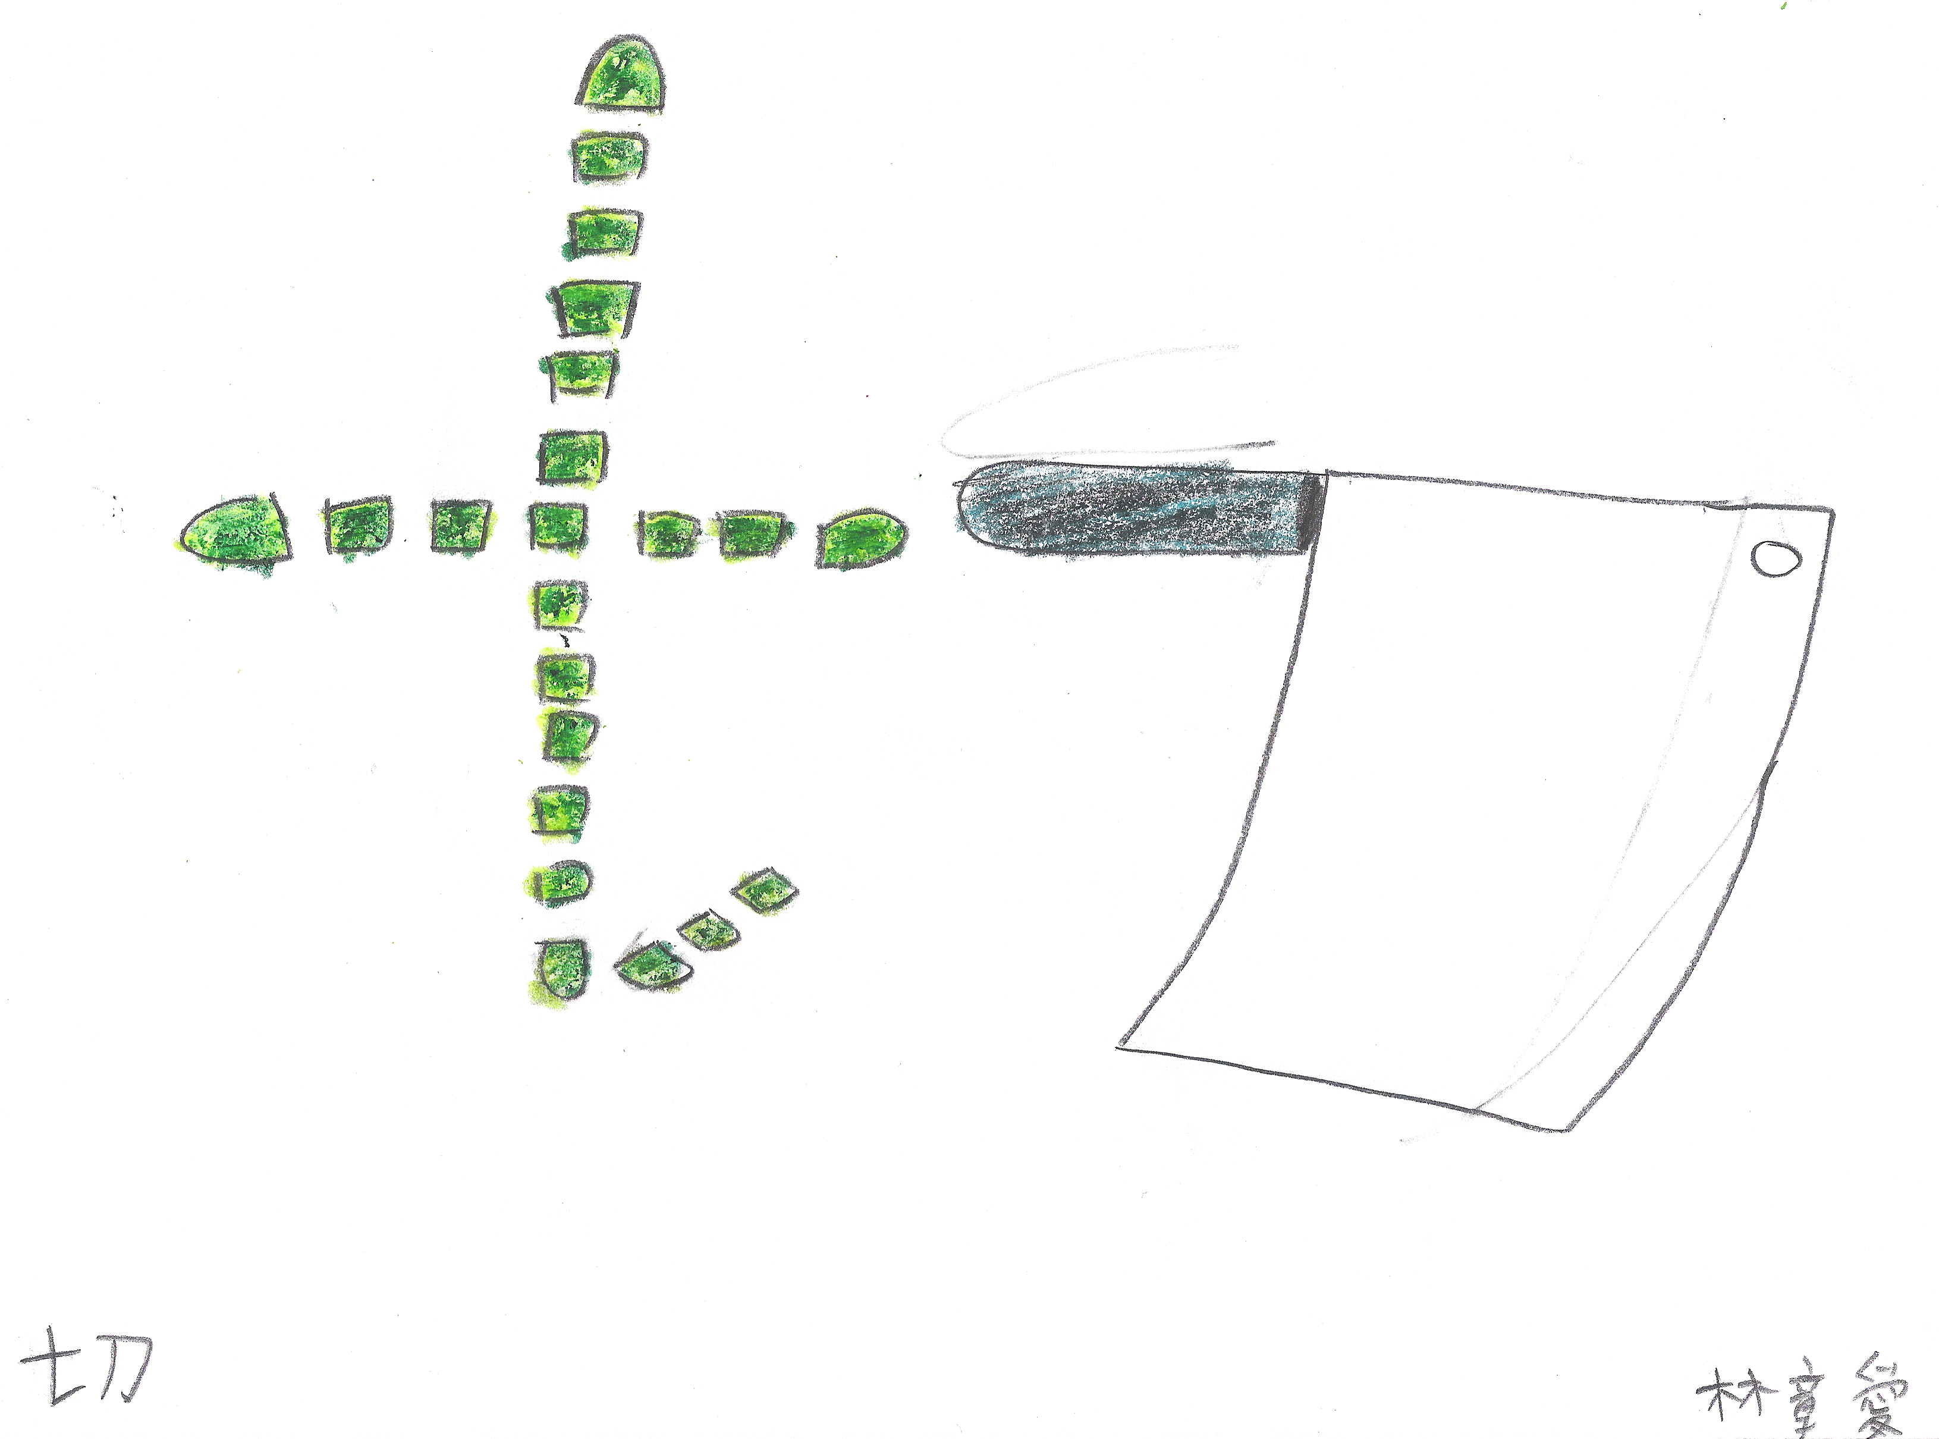
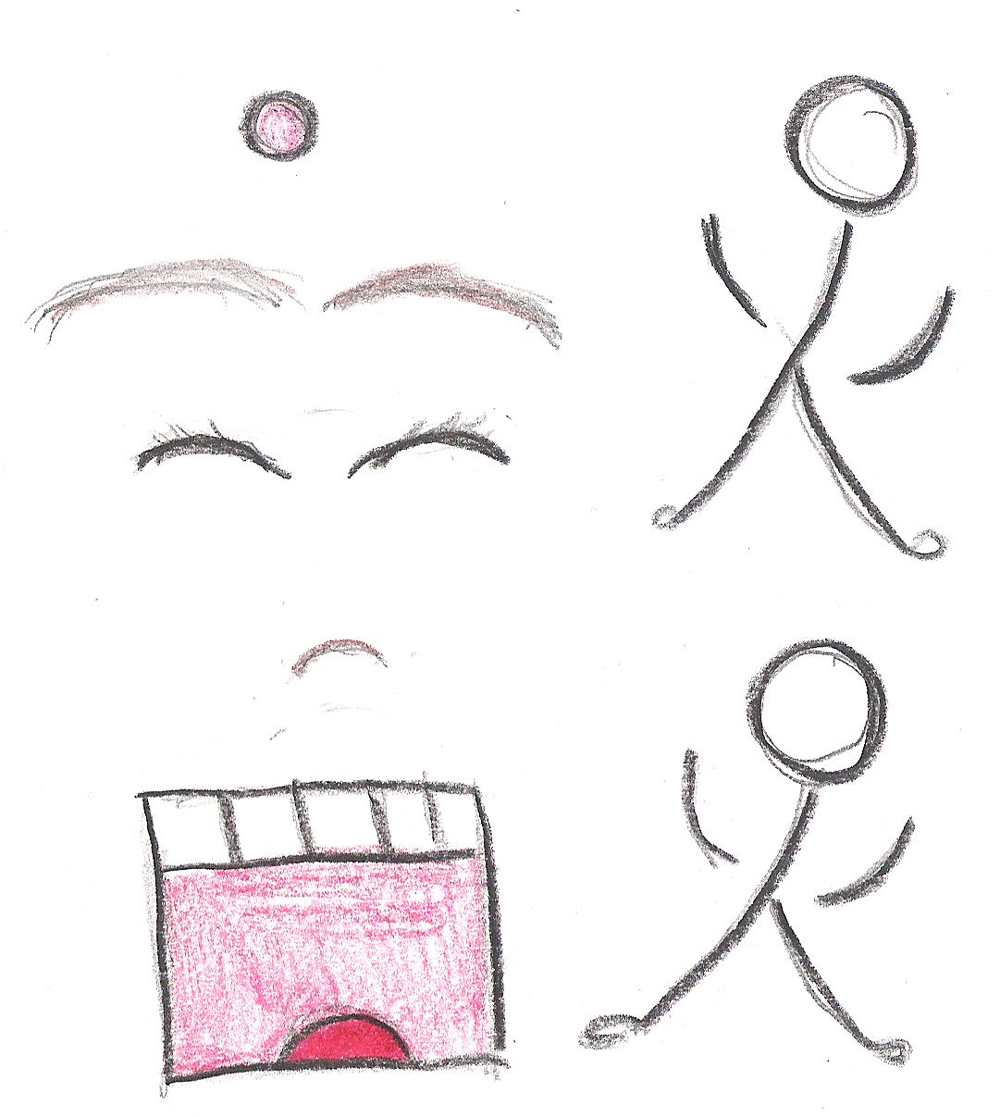
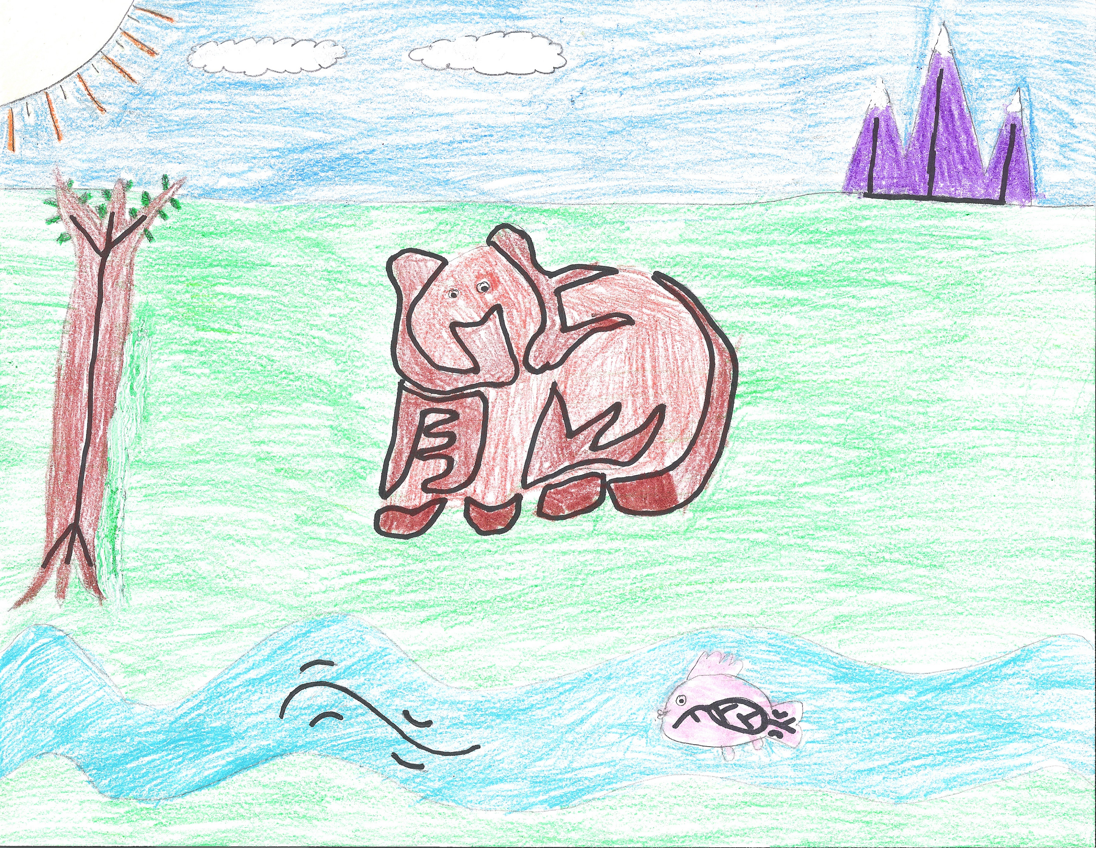
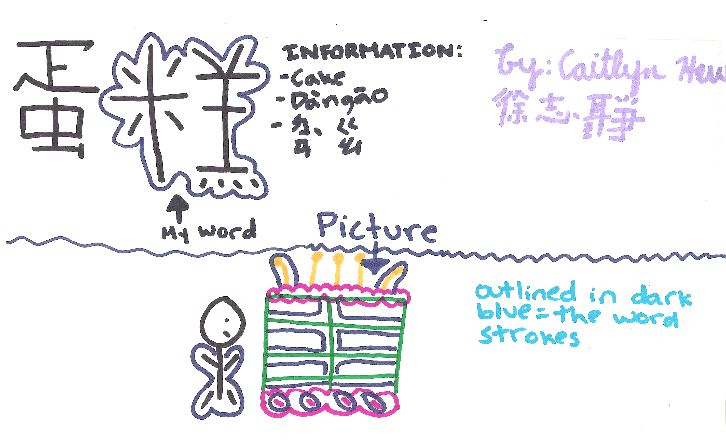
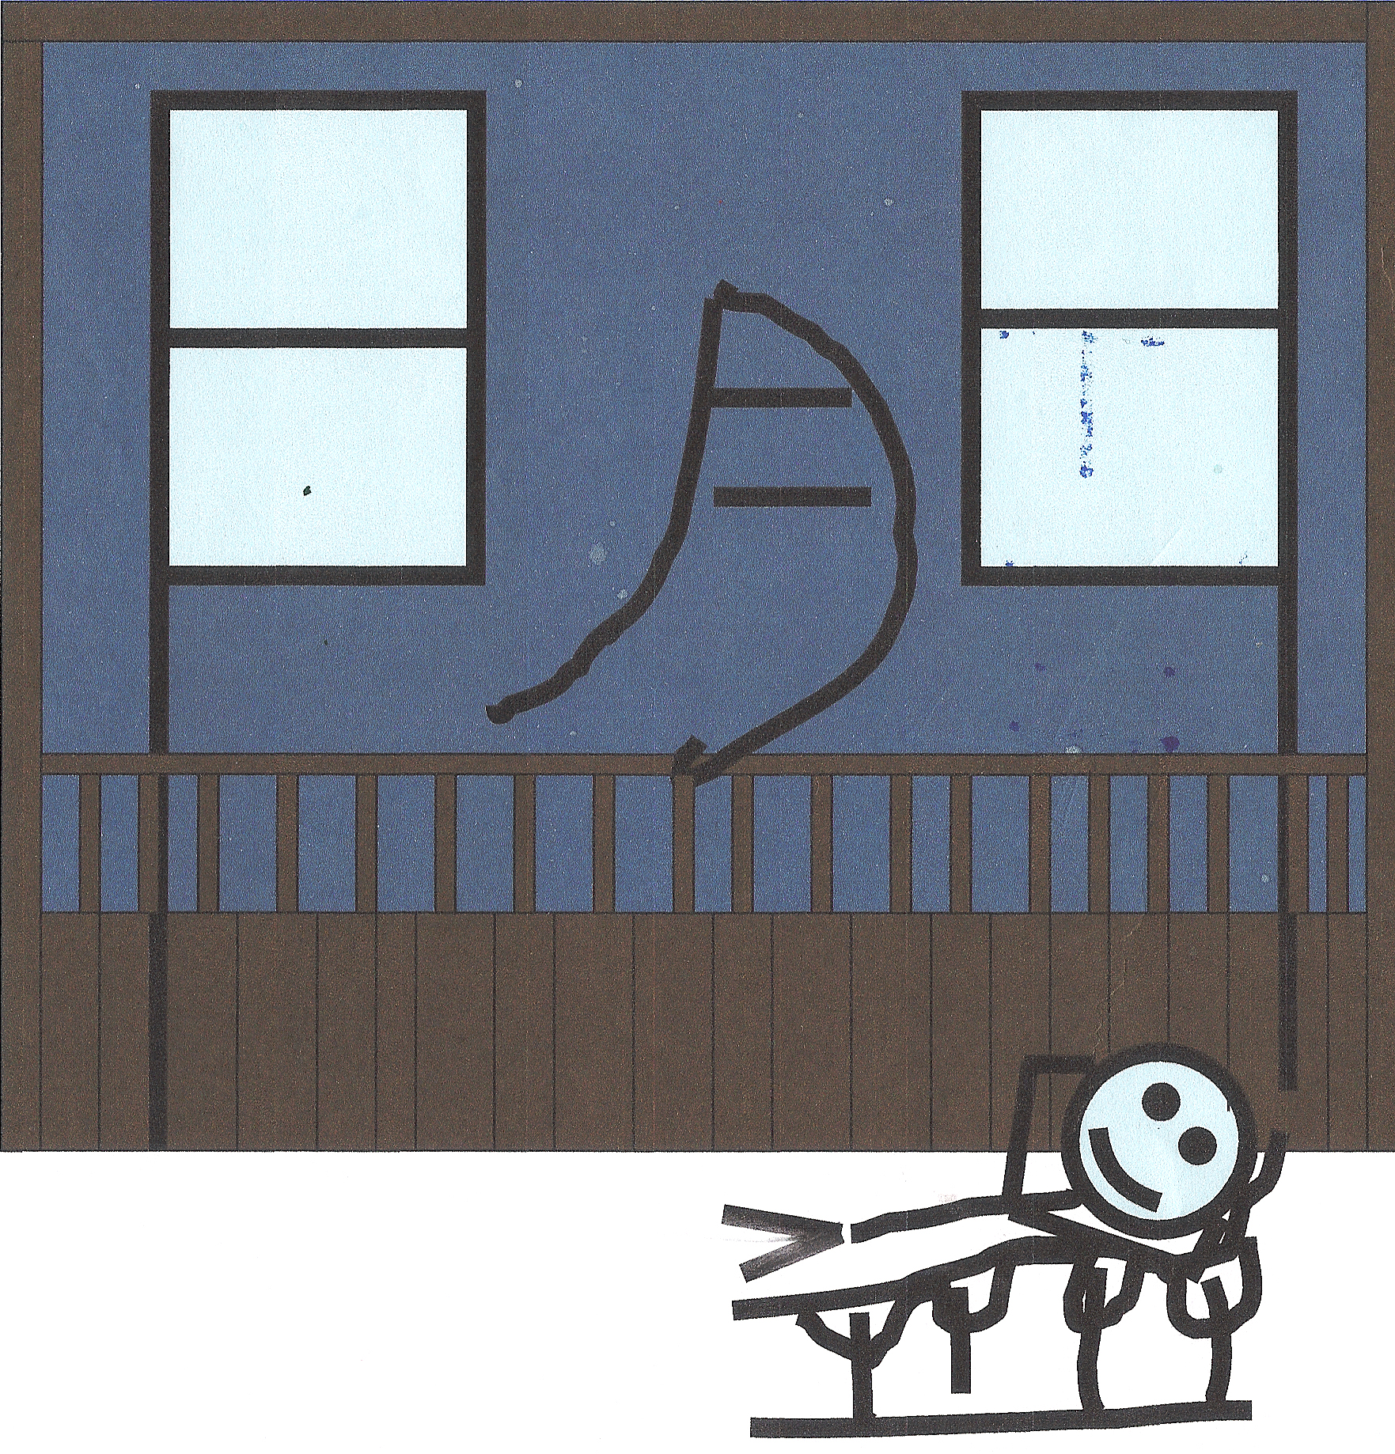
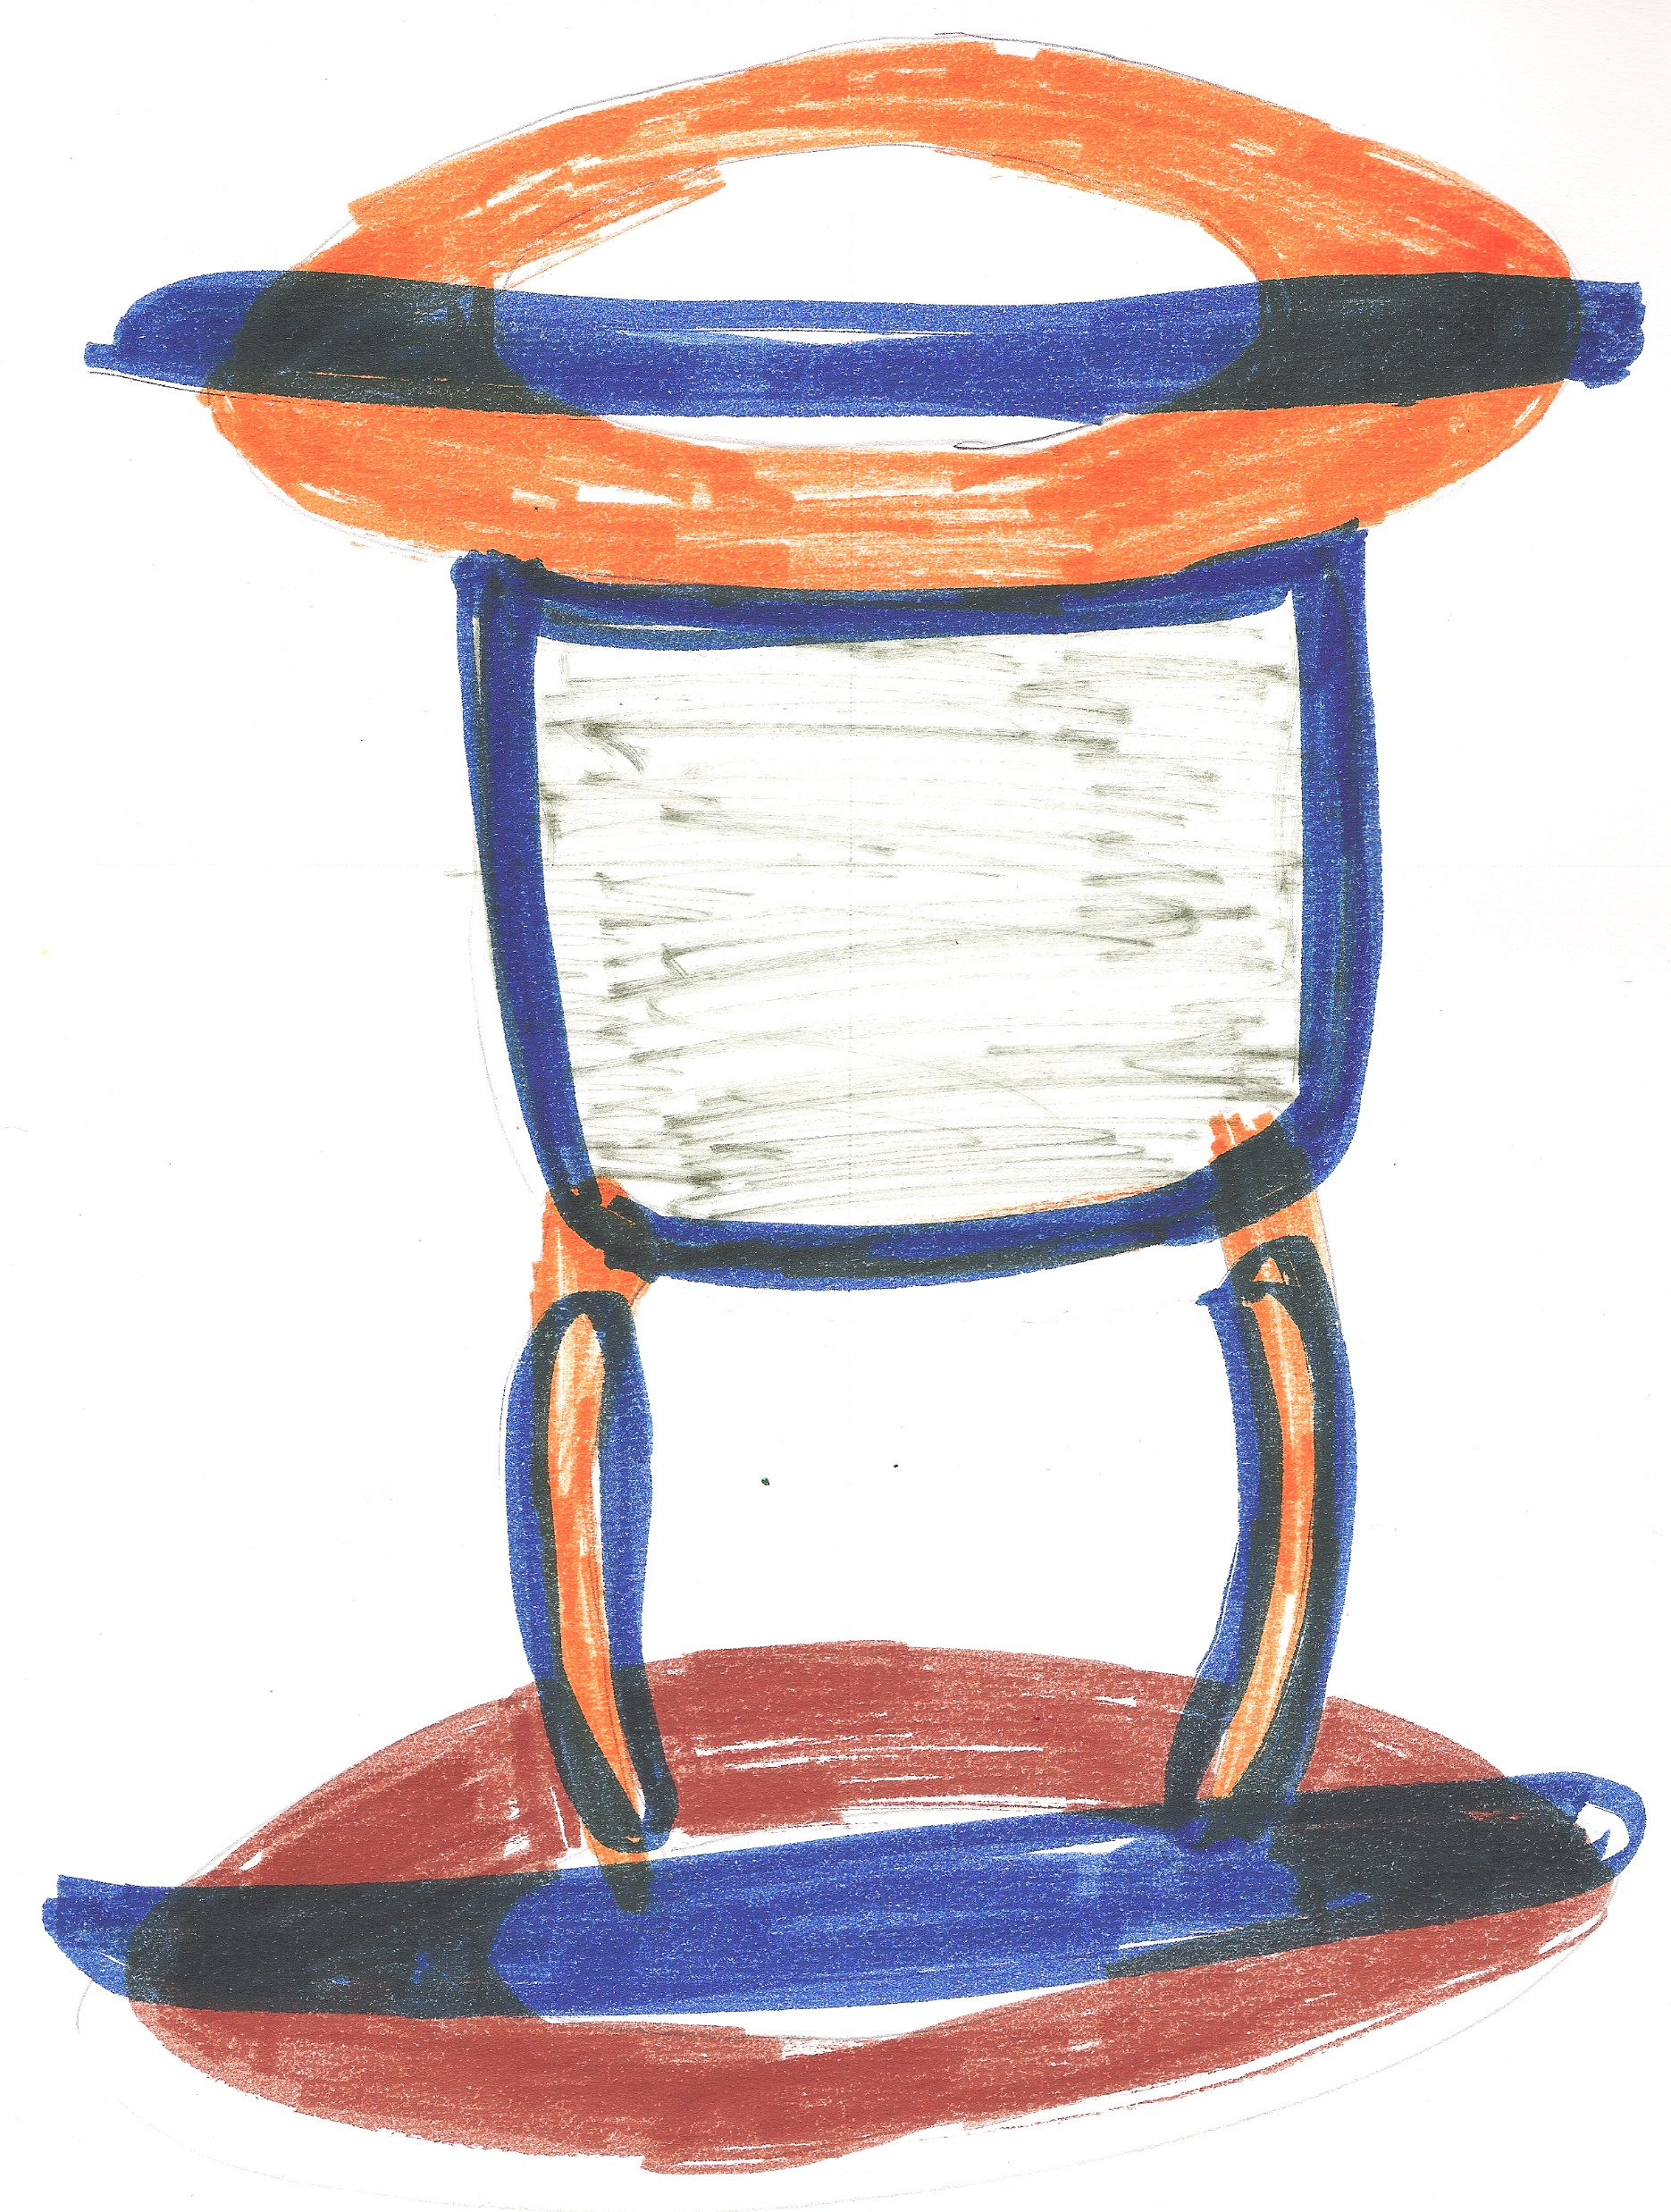
CAoC 5th Grade Parent Conference
Curriculum
Based on Students’ learning ability
Focus on
Chinese Characters Recognition
Make phrases
Make sentences
Reading
(*Writing)
How to memorize Chinese characters?
Radical/Component (meaning) & Pronunciation
Hieroglyphics
切
談
熊
閒
豆
廚

Slide 3
CAoC 5th Grade Parent Conference
Curriculum
Deemphasize Writing
Most of the writing was done in class
Not enough time
AP test – Chinese Typing
Using Google Translation/ChatGPT

Slide 4
CAoC 5th Grade Parent Conference
Auxiliary Tools
Handouts
Pen/Pencil
Mobile Devices (Laptop/Tablet/Smart Phone)
*Zoom Meeting

Slide 5
CAoC 5th Grade Parent Conference
Homework
MeiZhou Chinese
Story Telling Contest/Academic Contest
Graduation Ceremony Performance
*Parents, please help!! (Extra tutoring hour?)

Slide 6
CAoC 5th Grade Parent Conference
Evaluation
5 tests each semester
Open Notes
*Internet search allowed
50 minutes
Wheel of Fortune (Competition)
Escape Room (Cooperation)
https://www.youtube.com/watch?v=1NuKruZNM1c

Slide 7
CAoC 5th Grade Parent Conference
Story Telling Contest
Make a Speech
Multimedia Presentation
Crosstalk
Karaoke
YouTuber

Slide 8
CAoC 5th Grade Parent Conference
Student Absences
Watch class recording video at home
Live Online Zoom Meeting—
(*Need to be noticed in advance)

Slide 9
CAoC 5th Grade Parent Conference
Snowday
Check school website after 9:00am
Check email/text message/voice mail
Live Online Zoom Meeting

Slide 10
CAoC 5th Grade Parent Conference
Special Dates
09/23/2023
Teacher’s Day/Moon Festival Celebration
10/28/2023
Story Telling Contest
11/25/2023
Thanksgiving - No School!
12/16/2023
Cultural Week

Slide 11
CAoC 5th Grade Parent Conference
Special Dates
02/10/2024
Lunar New Year Celebration
03/13/2024 & 03/30/2024
Spring Break - No School
04/06/2024
Academic Contest
05/04/2024
Graduation Ceremony

Slide 12
CAoC 5th Grade Parent Conference
Q & A
Chao-Hsu Yao
Cell Phone: 216-630-3276
Email: chy@case.edu

