Slide 1
吳錦龍
Andrew Haas
Class of 2022

Slide 2
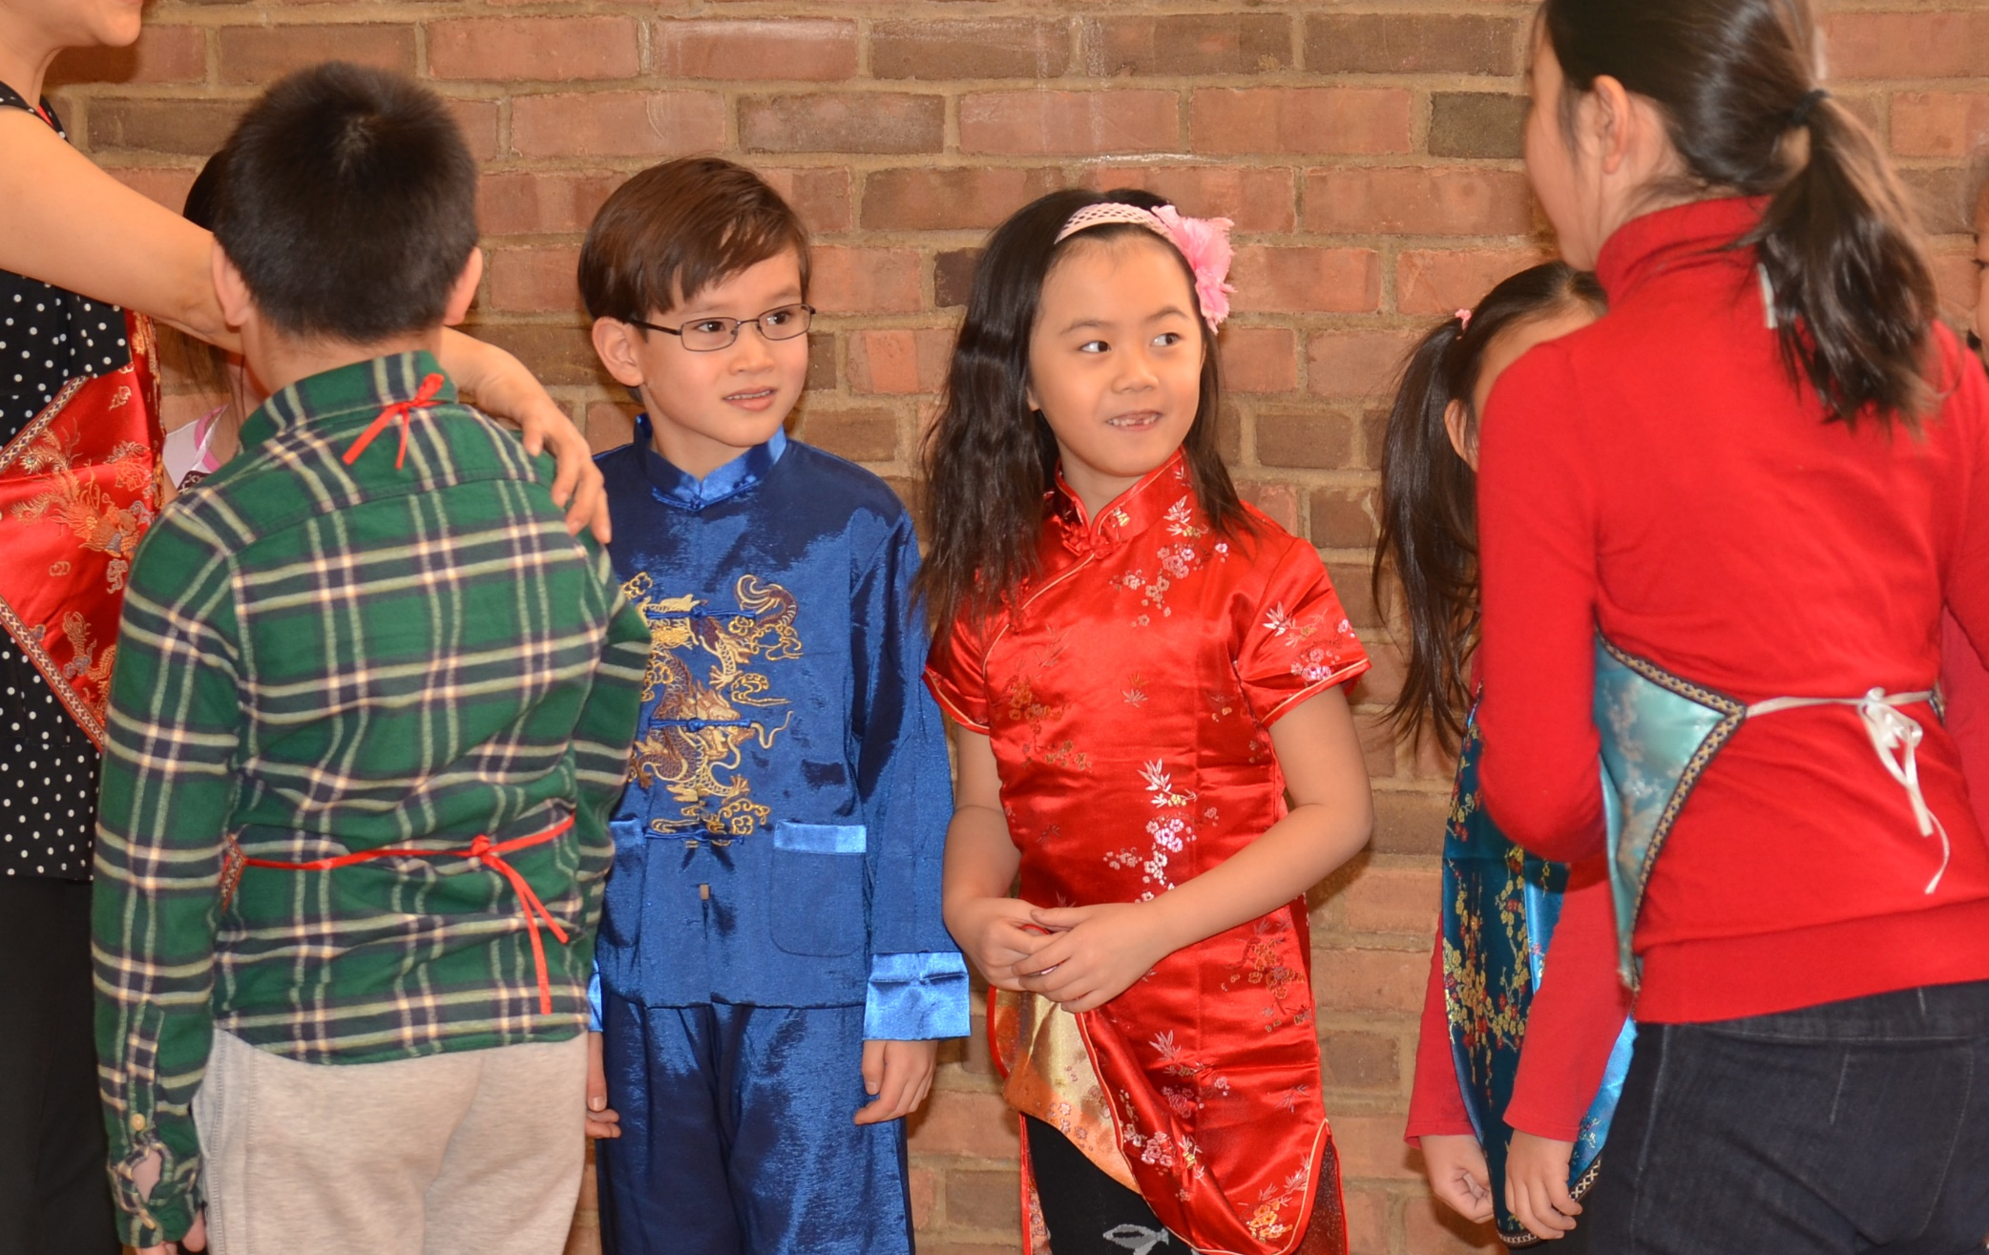
After 9 years, I have many people to thank
九年過後，我有很多的人要感謝
吳錦龍
Andrew Haas
Class of 2022
02/07/2015

Slide 3
including my teachers, my classmate, and family for helping me,
—我的老師、我的同學、和我的家人。
吳錦龍
Andrew Haas
Class of 2022
02/07/2015

Slide 4
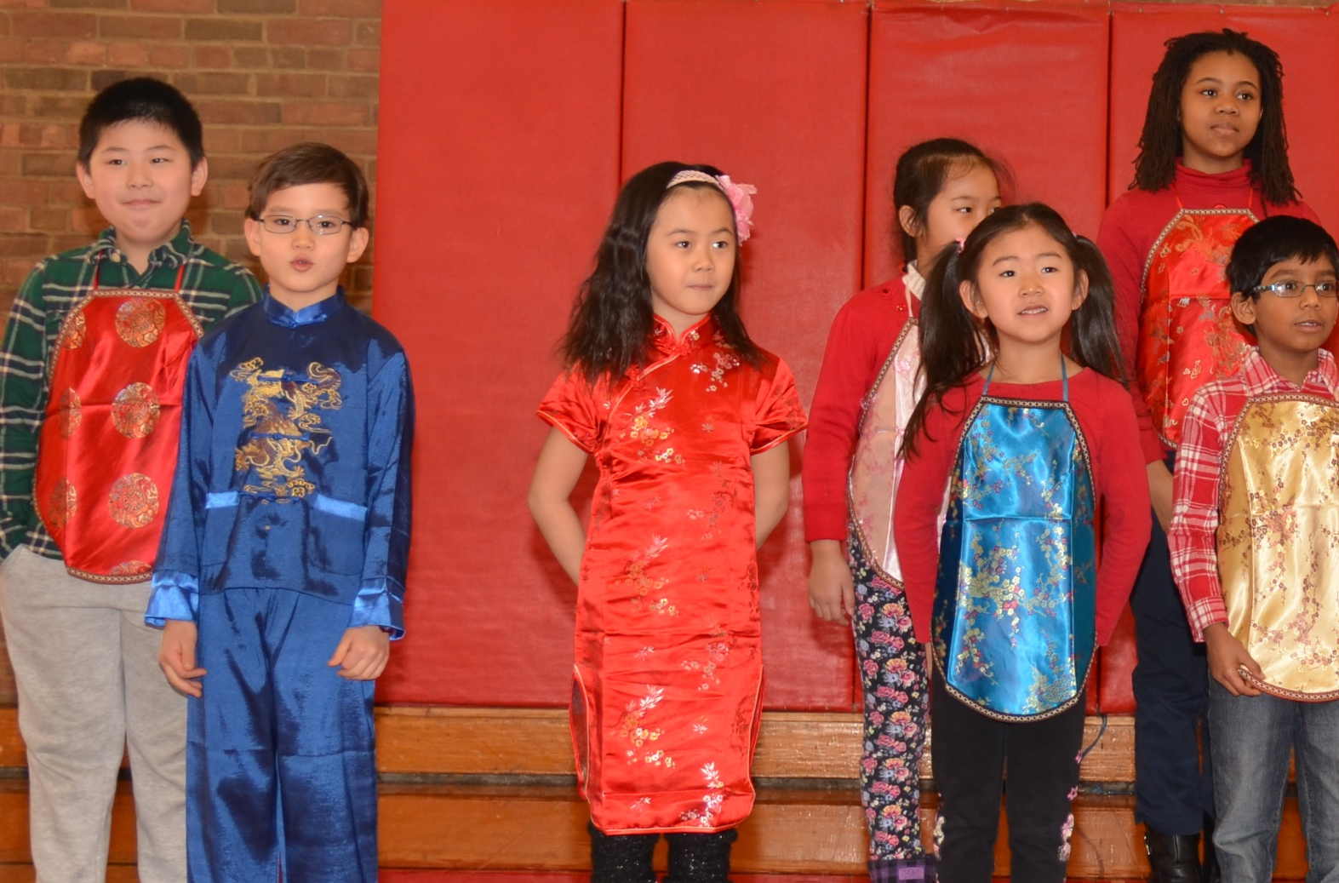
but I really have to thank my Gong-Gong and Po-Po.
我要感謝我的公公和婆婆
吳錦龍
Andrew Haas
Class of 2022
02/07/2015

Slide 5
They both helped me learn Chinese and also drive my brother and I to school every week.
教我和弟弟做功課，並且帶我們去學校。
吳錦龍
Andrew Haas
Class of 2022
02/07/2015

Slide 6
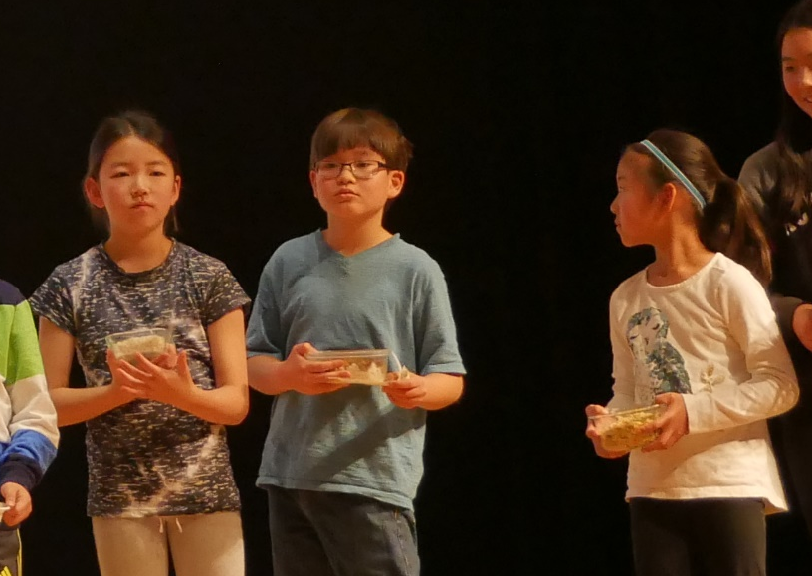
I also have to thank my mom and dad for making sacrifices to send me to Chinese school.
我也要感謝我的爸爸媽媽犧牲他們的時間栽培我。
吳錦龍
Andrew Haas
Class of 2022
04/29/2017

Slide 7
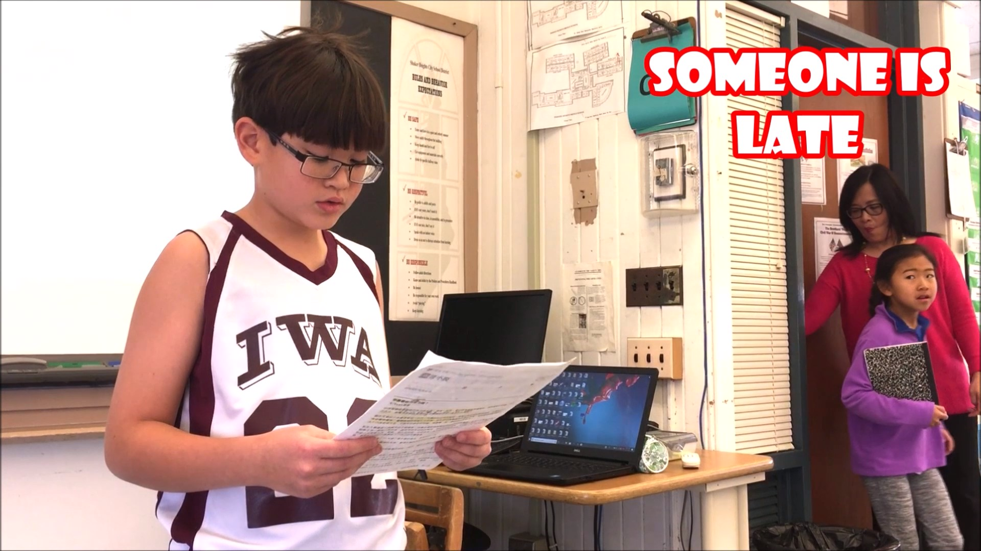
Now it’s no surprise that Chinese was hard to learn,
現在，我覺得中文真的很難學，
吳錦龍
Andrew Haas
Class of 2022
12/02/2017

Slide 8
but after learning this language for many years,
但是學中文很多年以後，
吳錦龍
Andrew Haas
Class of 2022
12/02/2017

Slide 9
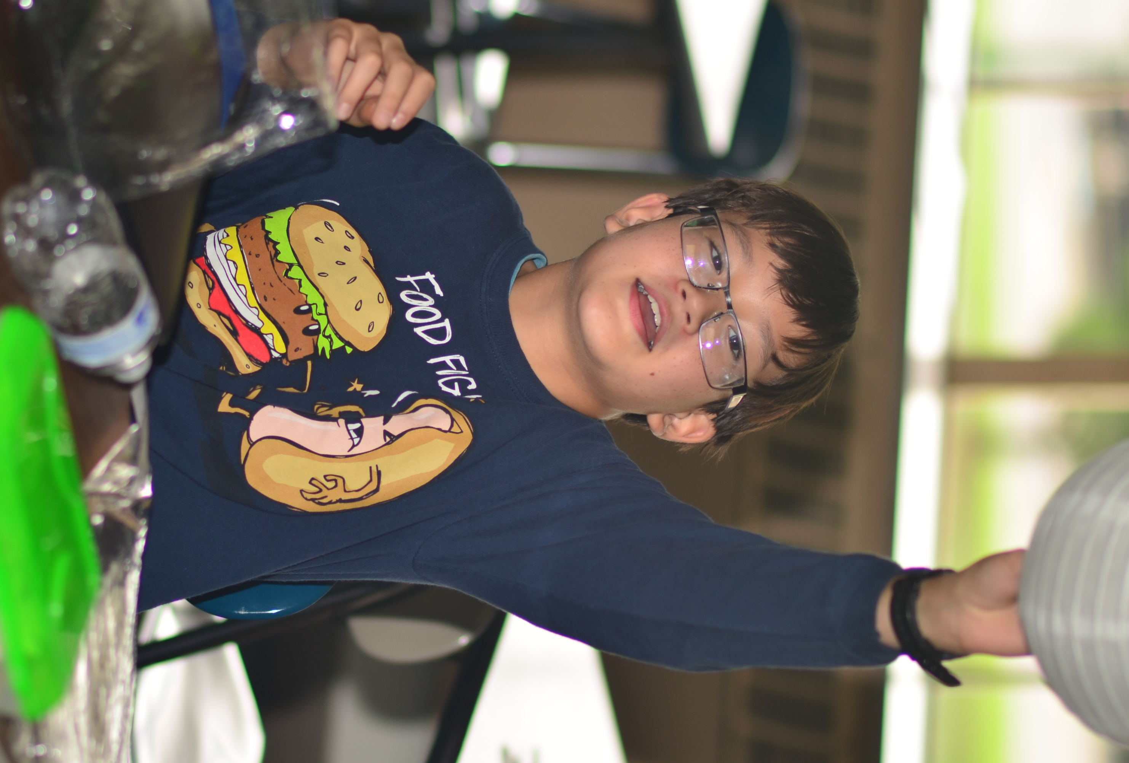
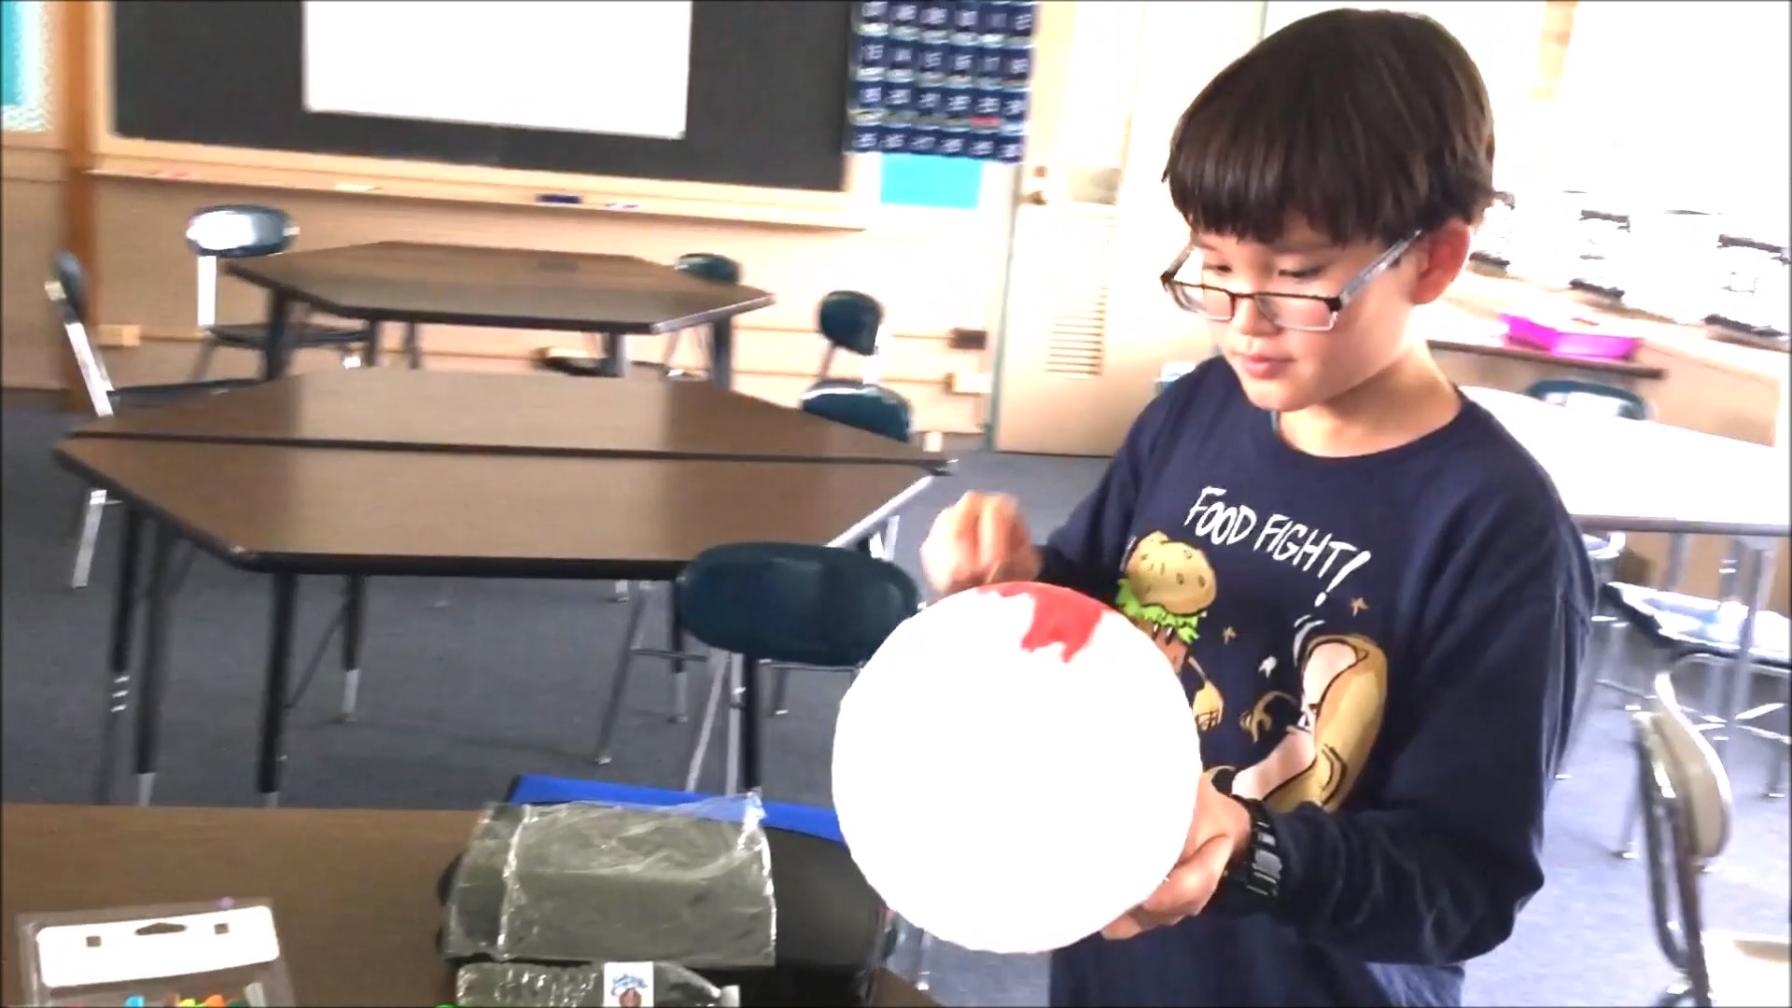
and seeing the results, from traveling to Taiwan.
從去台灣旅行六次，可以看見結果。
吳錦龍
Andrew Haas
Class of 2022
09/22/2018

Slide 10
I have to say, stick with it and the result will speak for themselves.
我必須說，保持學習，你就會看到結果。
吳錦龍
Andrew Haas
Class of 2022
09/22/2018

Slide 11
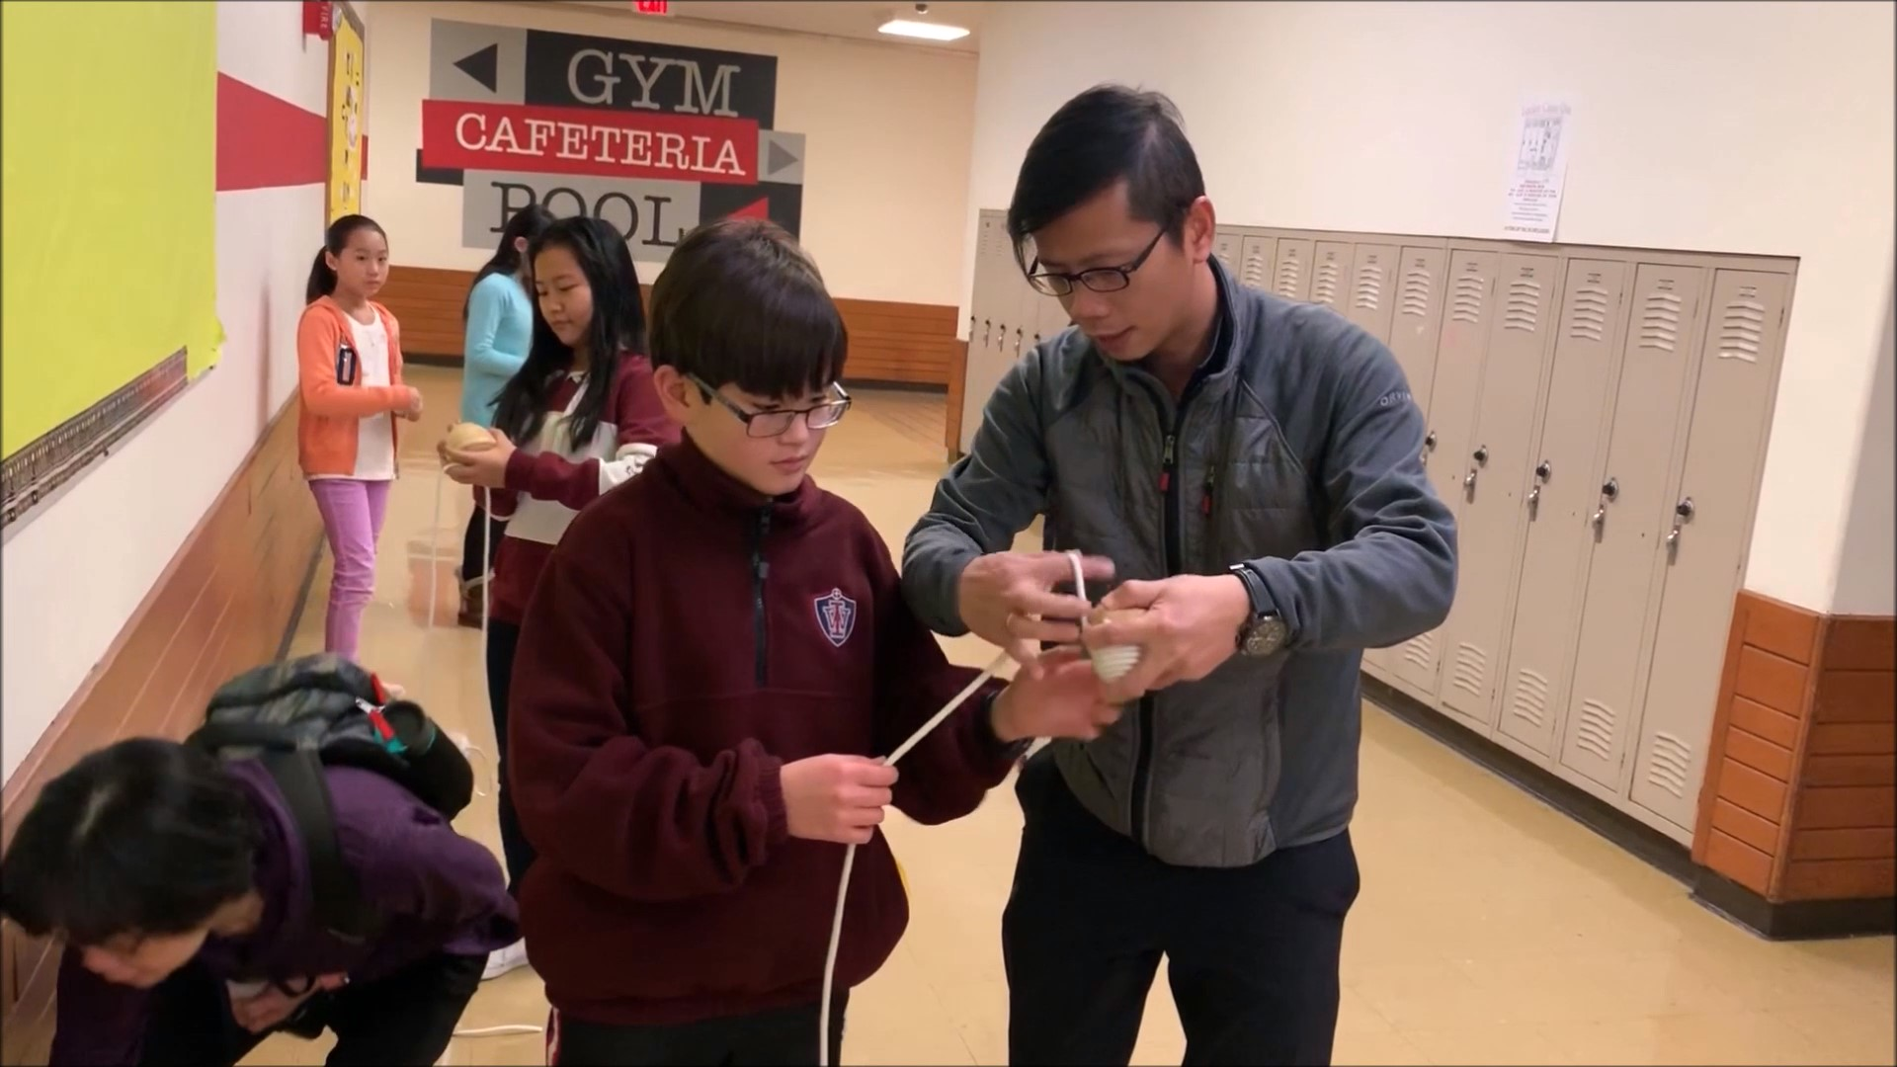
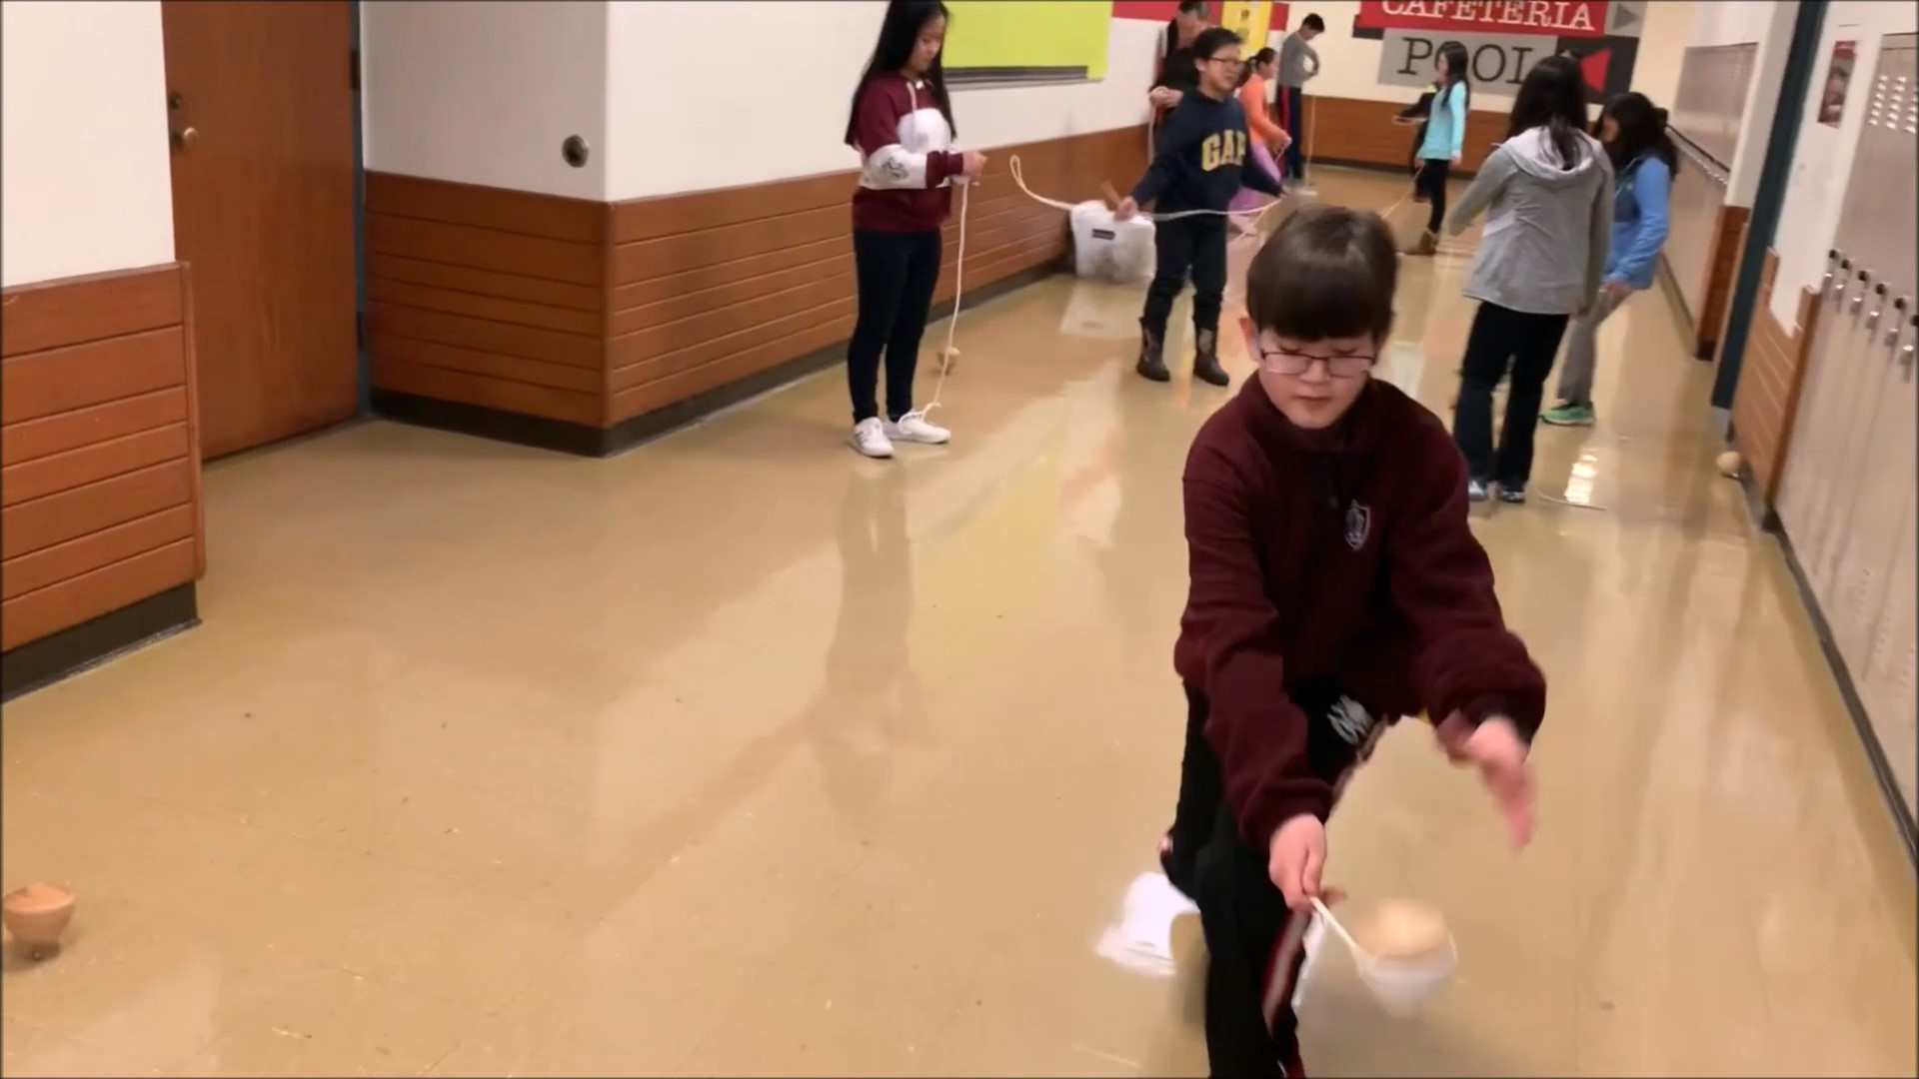
You will be where I am standing today proud to graduate.
你就會像我今天一樣站在這裡，驕傲地畢業。
吳錦龍
Andrew Haas
Class of 2022
12/15/2018

Slide 12

I have to thank the teachers again,
我要再感謝我的老師，
吳錦龍
Andrew Haas
Class of 2022
03/10/2019

Slide 13
such as Mr. Yao for sacrificing their time every week
比如，姚老師，每星期犧牲很多時間，
吳錦龍
Andrew Haas
Class of 2022
03/10/2019

Slide 14
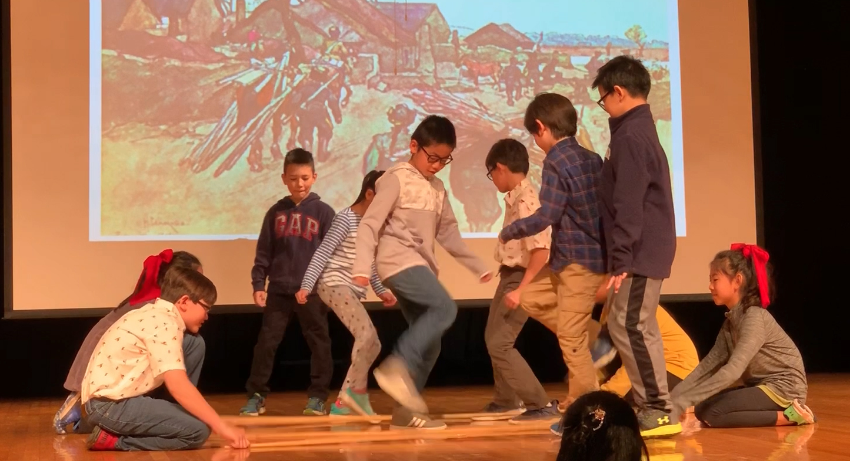
to help my classmates: Vivian, Iris, accomplish our wildest dreams of graduation.
幫我的同學Vivian、Iris和我，完成我們畢業的夢想。
吳錦龍
Andrew Haas
Class of 2022
05/04/2019

Slide 15
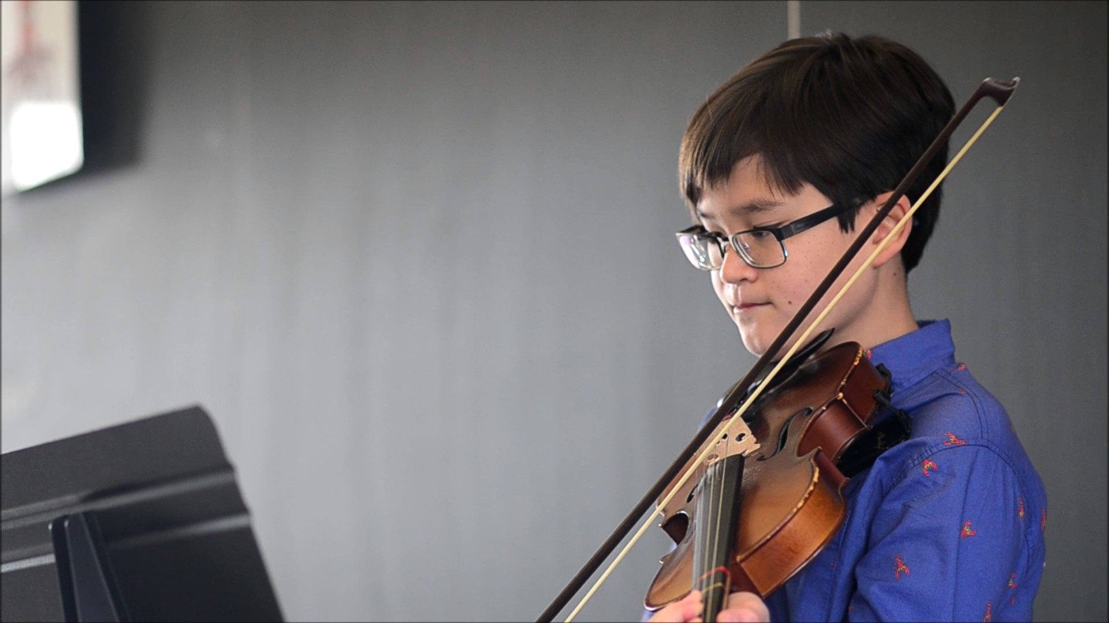
These years at CAoC have helped me in my travels to Taiwan
這些年在中文學校的學習，在我回台灣的時候，幫助很大。
吳錦龍
Andrew Haas
Class of 2022
11/02/2019

Slide 16

and I hope that your studies will help you as well
我希望你們的中文學習，也可以幫你
吳錦龍
Andrew Haas
Class of 2022
05/15/2021

Slide 17
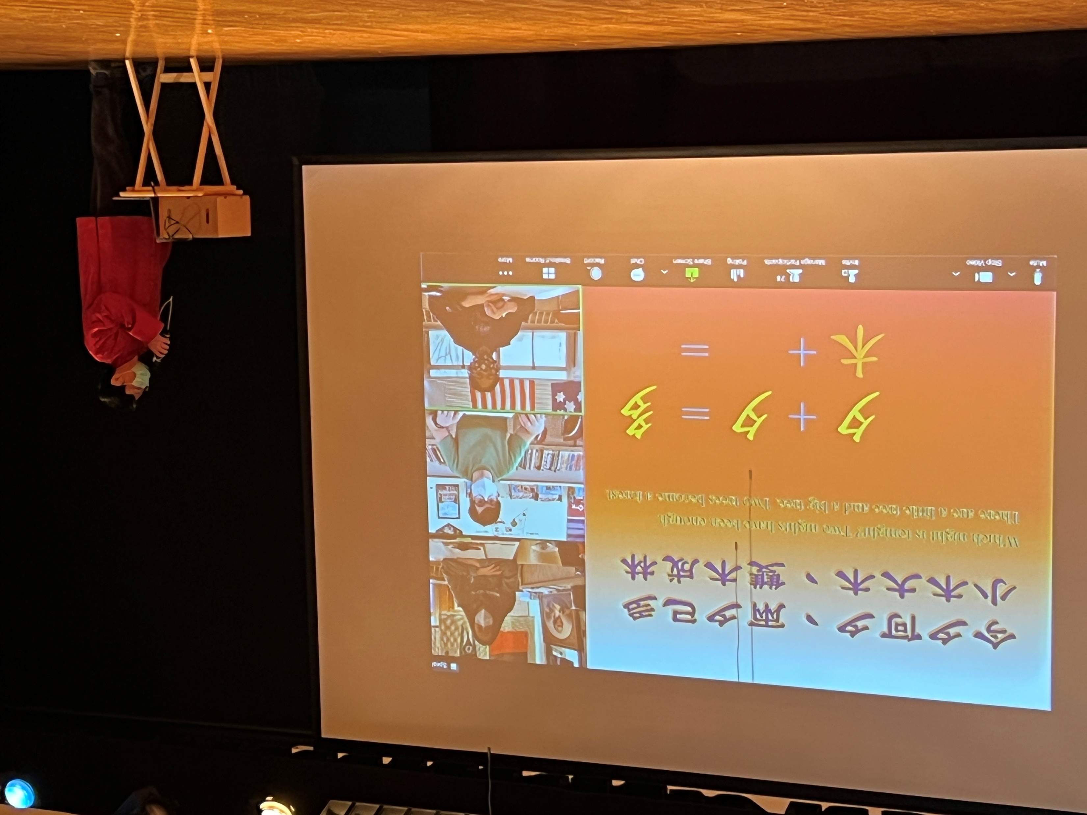
in your travels to Taiwan, China or wherever you may travel.
去中國、或是任何你可能去的地方。
吳錦龍
Andrew Haas
Class of 2022
02/05/2022

